Slide 1
COMPLETED PROJECTS
Kings Grant, Cabarrus County, Concord, North Carolina
Lake Las Vegas, Henderson, Nevada
Myrtle Beach Air Force Base, Myrtle Beach, South Carolina
Build-to-Suit Projects, Myrtle Beach, South Carolina
Build-to-Suit Projects (Southeast and Mid-West)

Slide 2
KINGS GRANT, CABARRUS COUNTY
CONCORD, NORTH CAROLINA

Slide 3
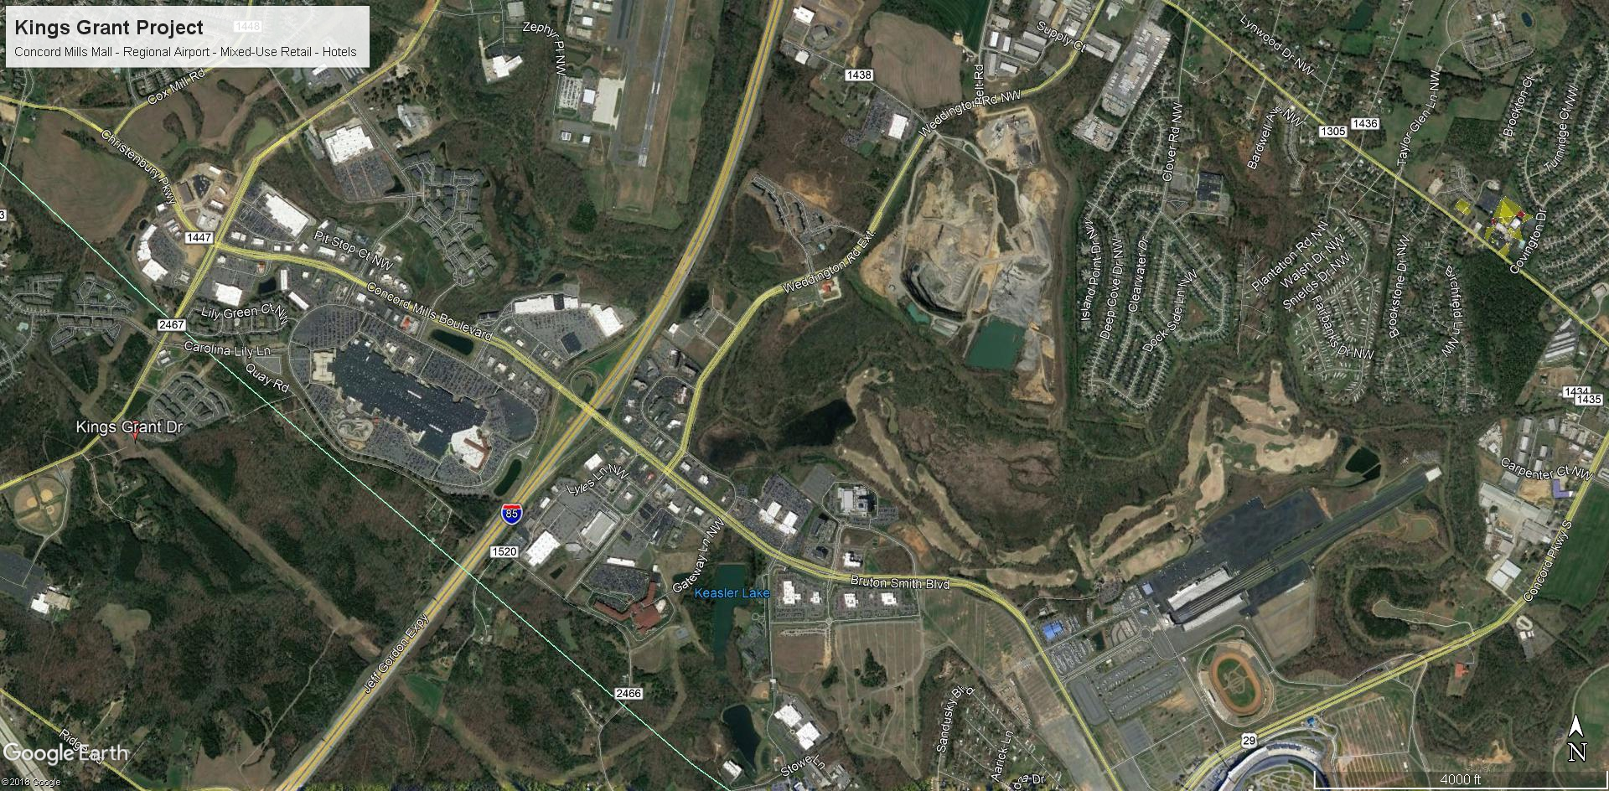

Slide 4
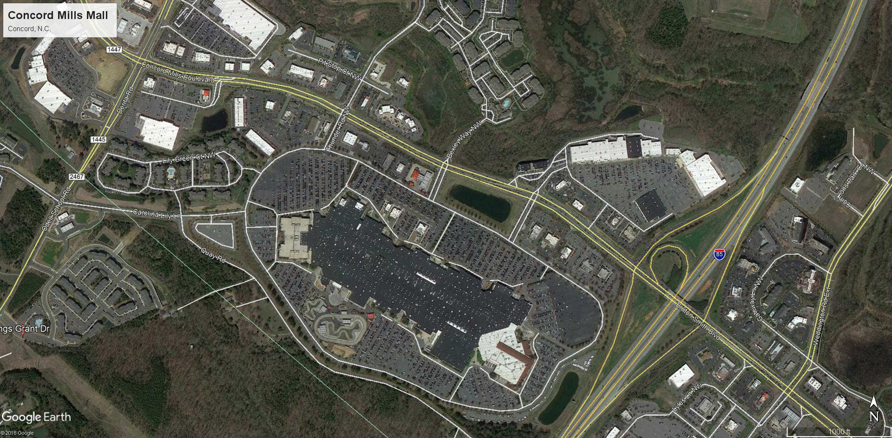

Slide 5
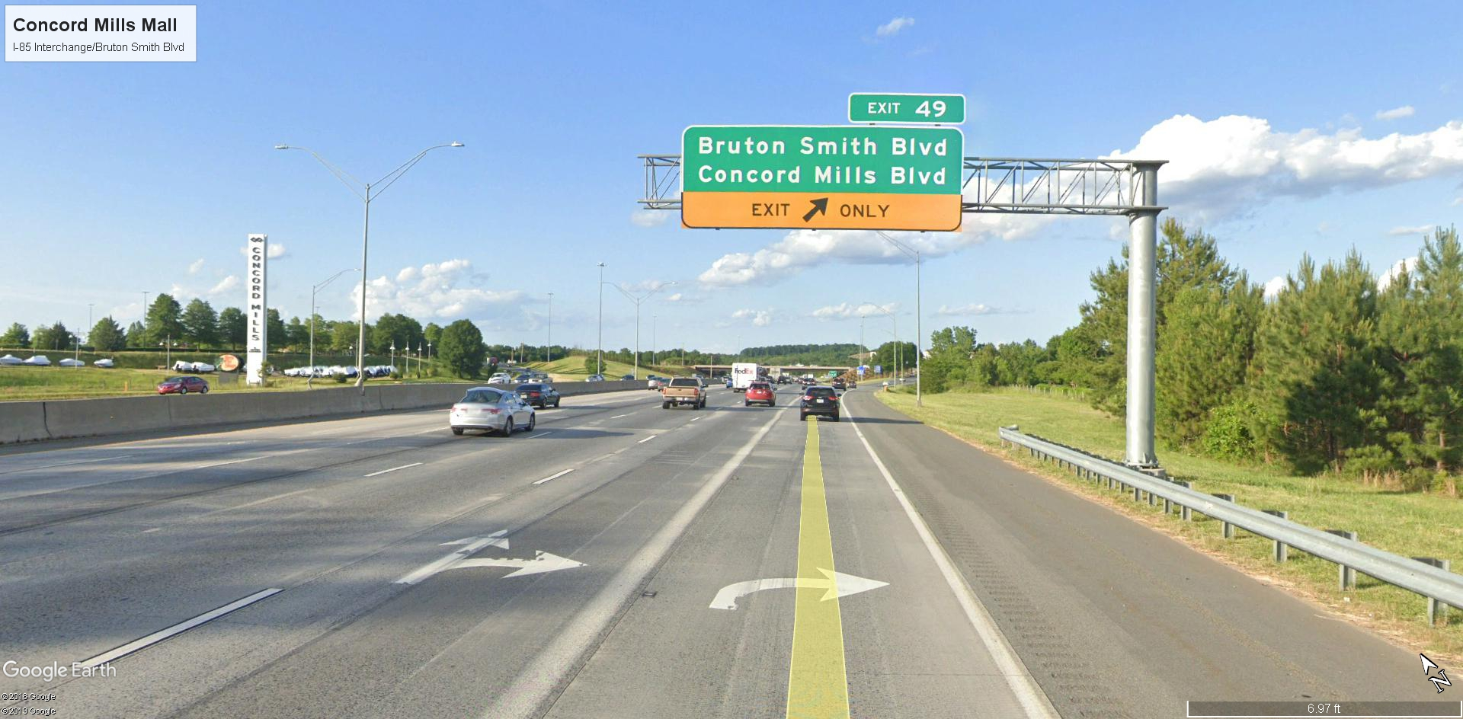

Slide 6
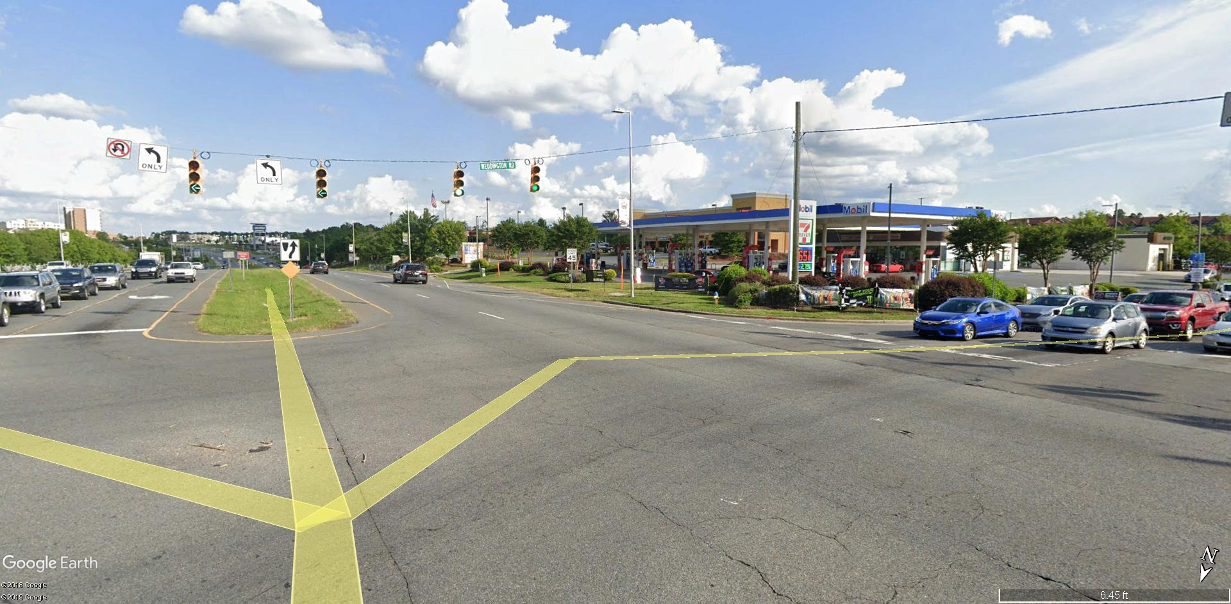

Slide 7
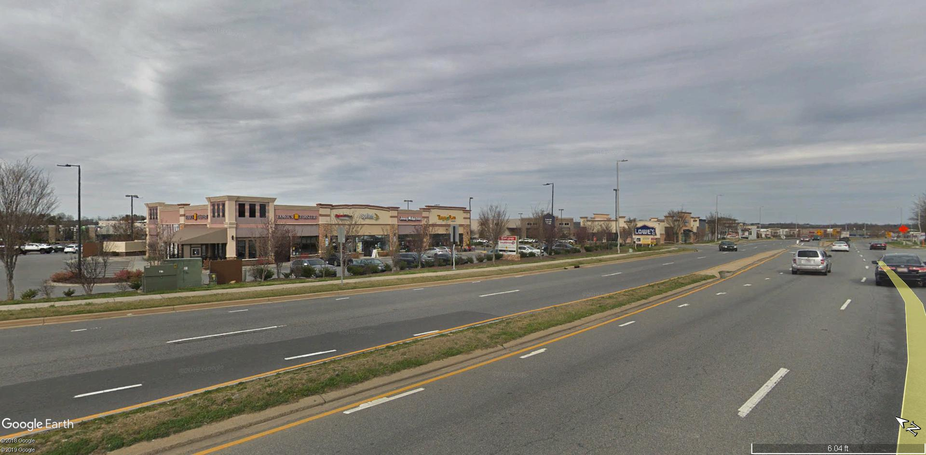

Slide 8
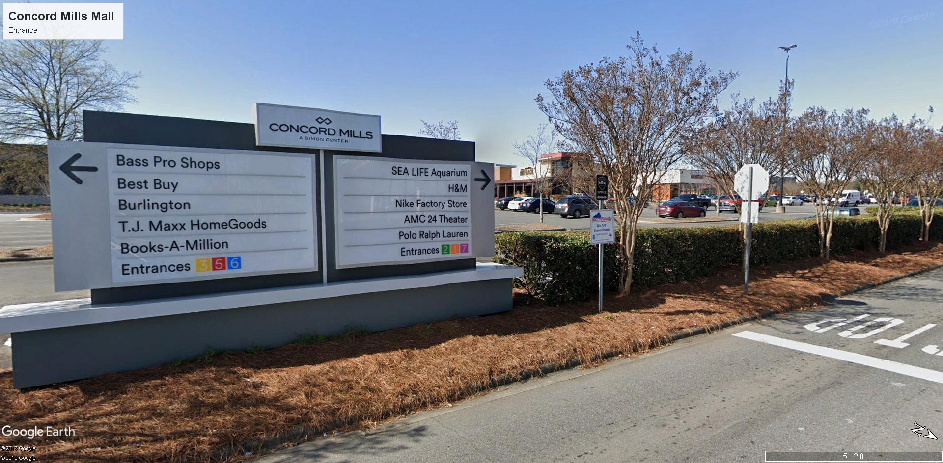

Slide 9
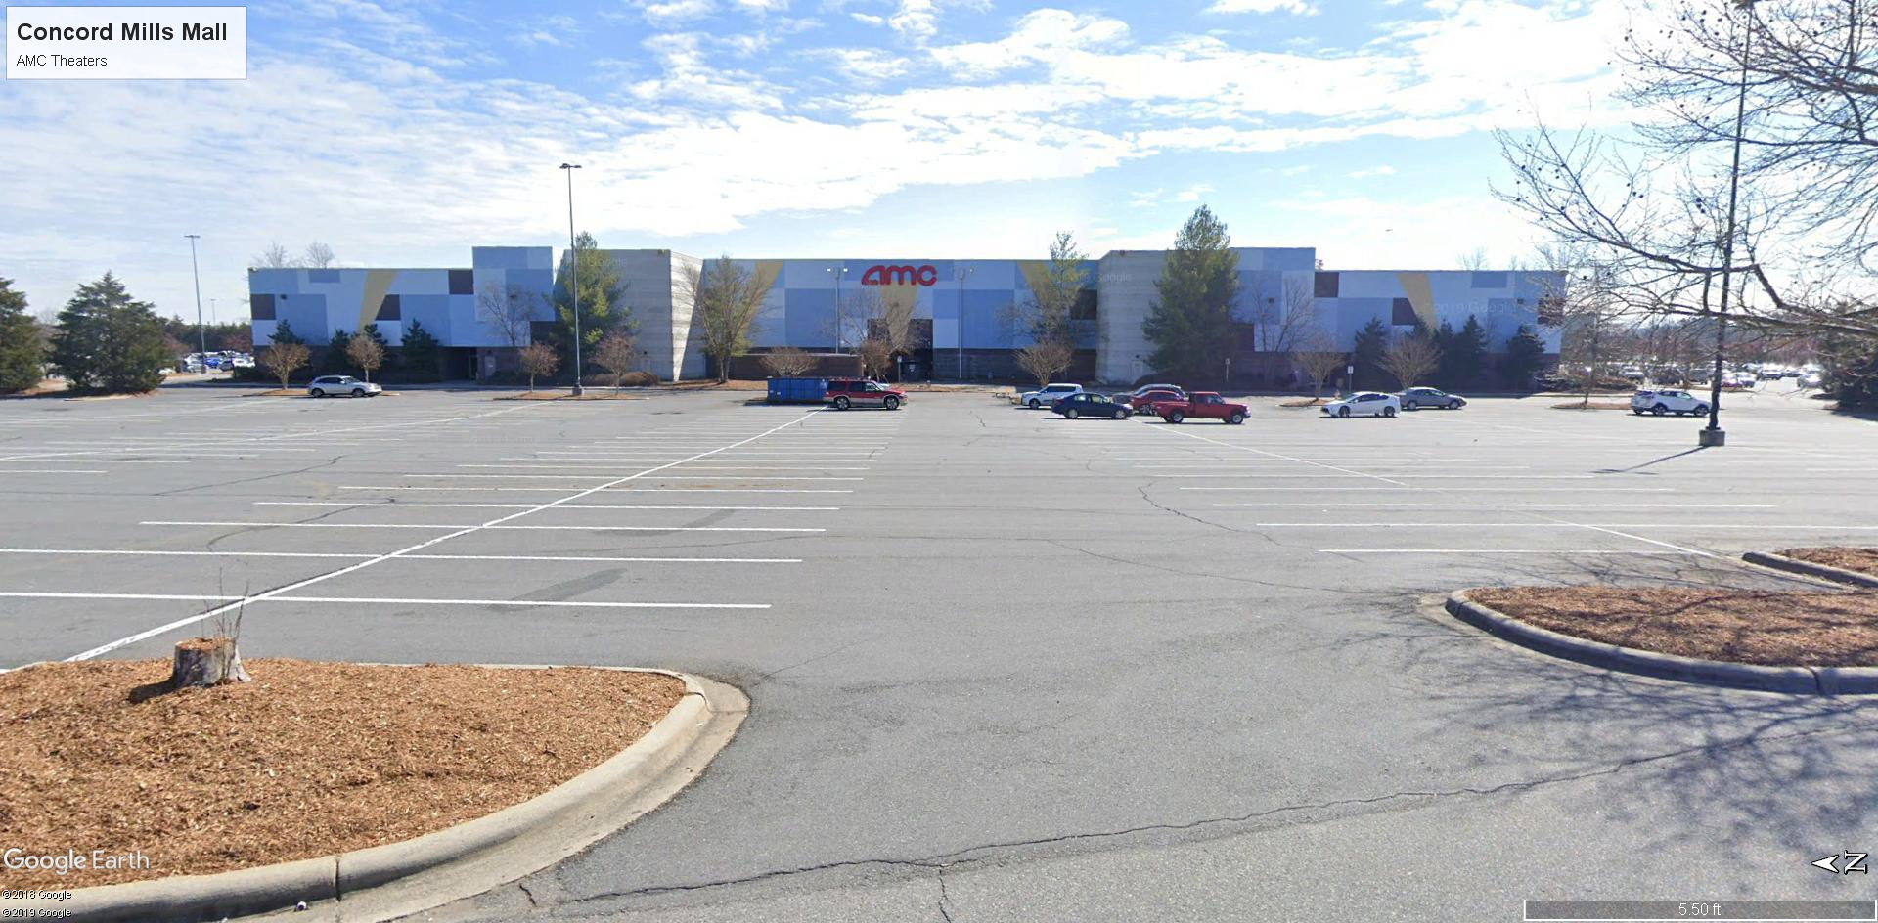

Slide 10
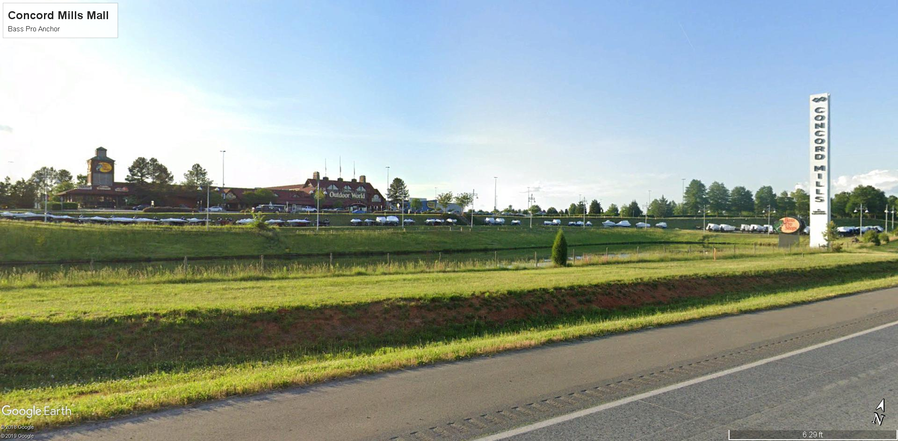

Slide 11
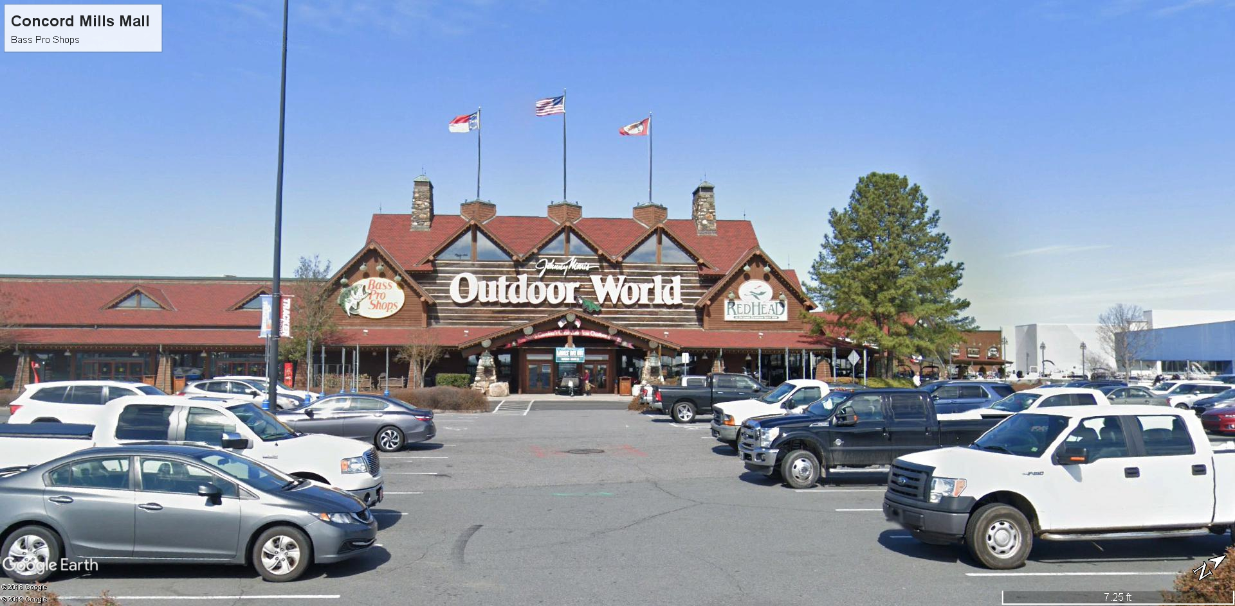

Slide 12
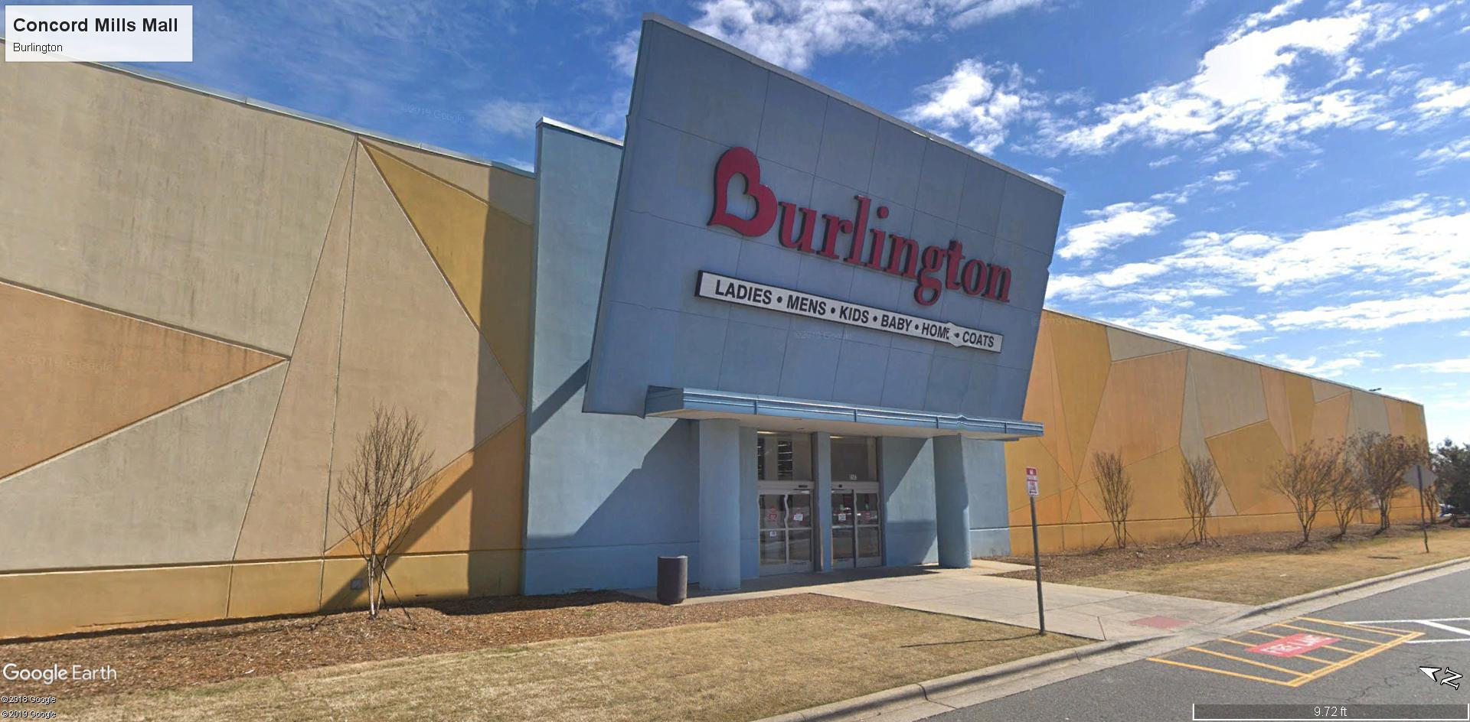

Slide 13
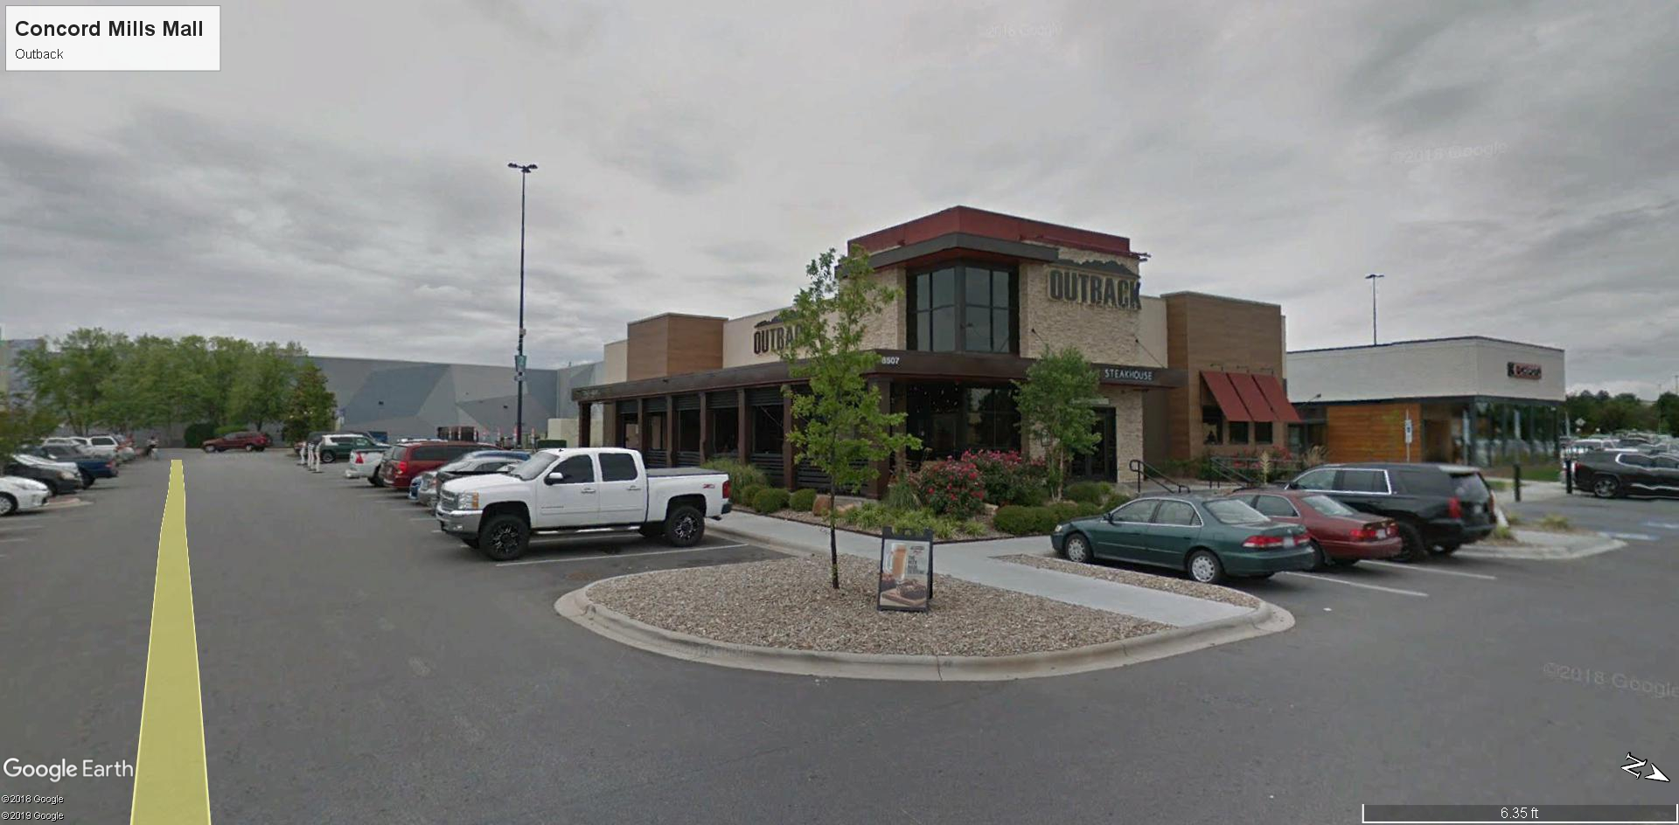

Slide 14
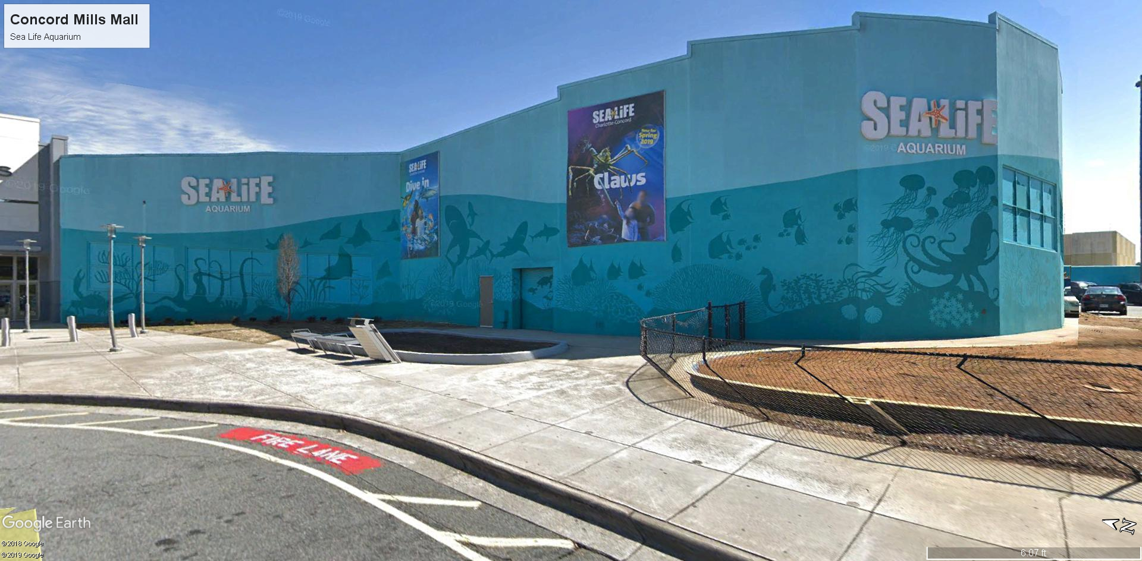

Slide 15
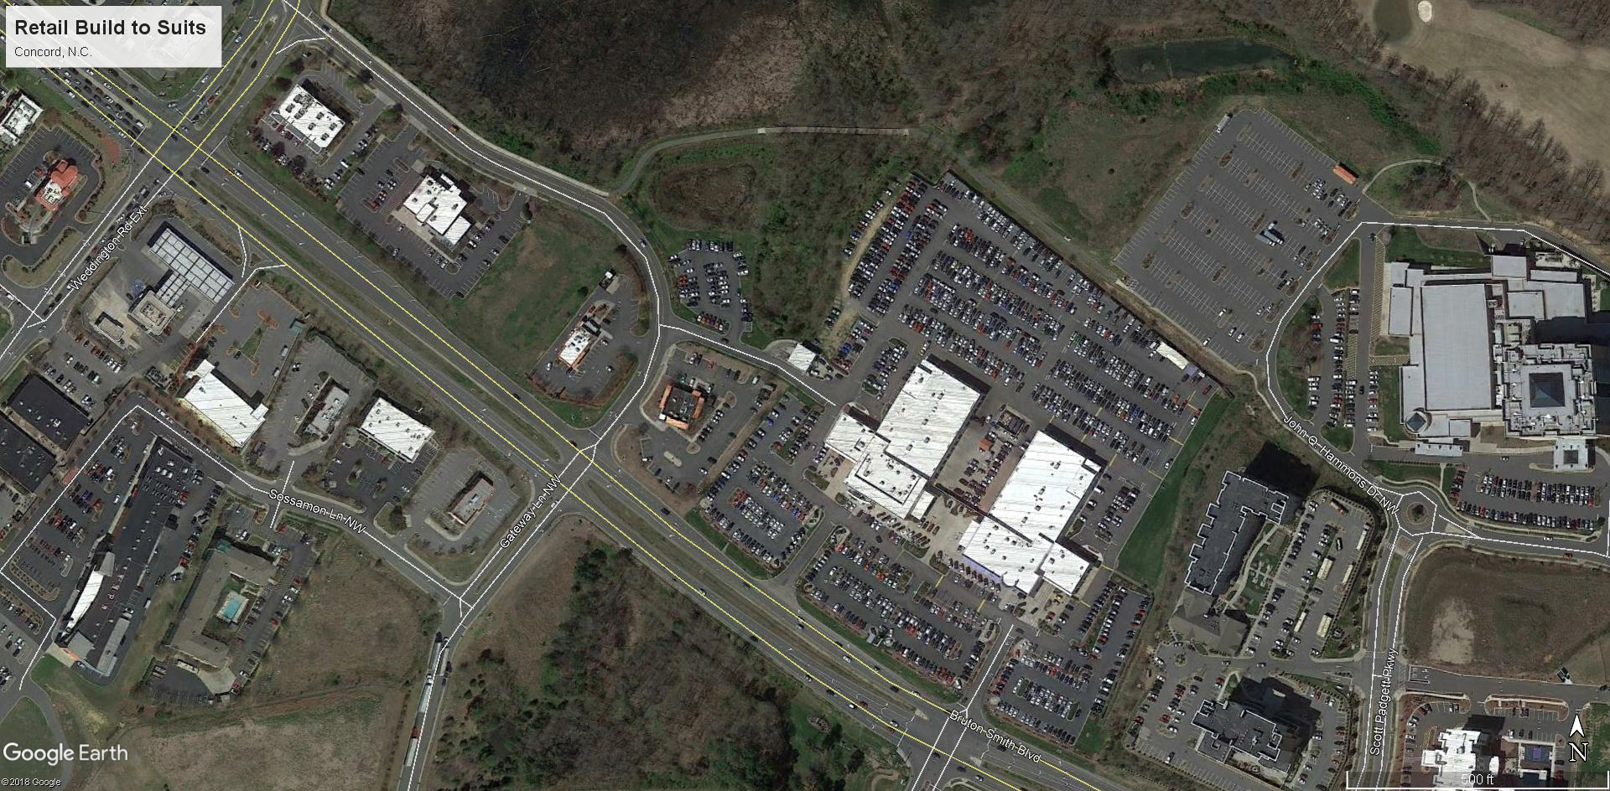

Slide 16
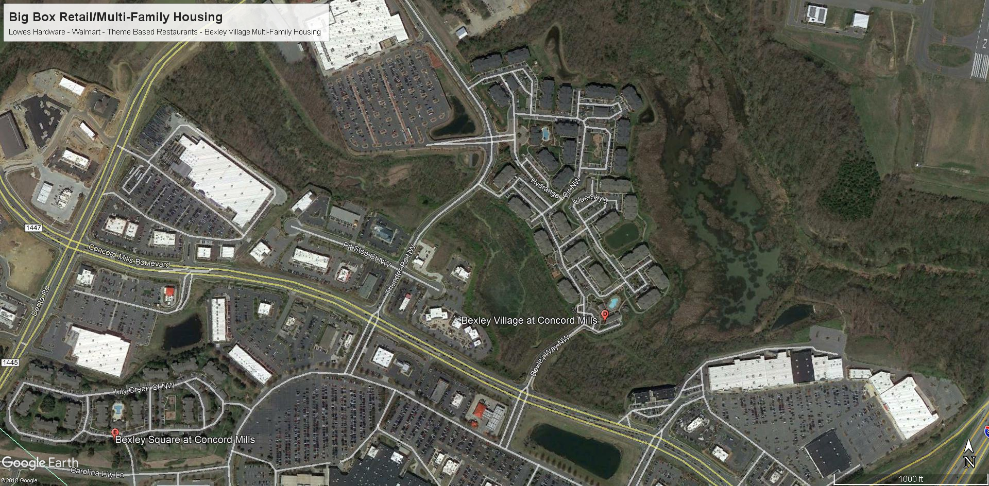

Slide 17
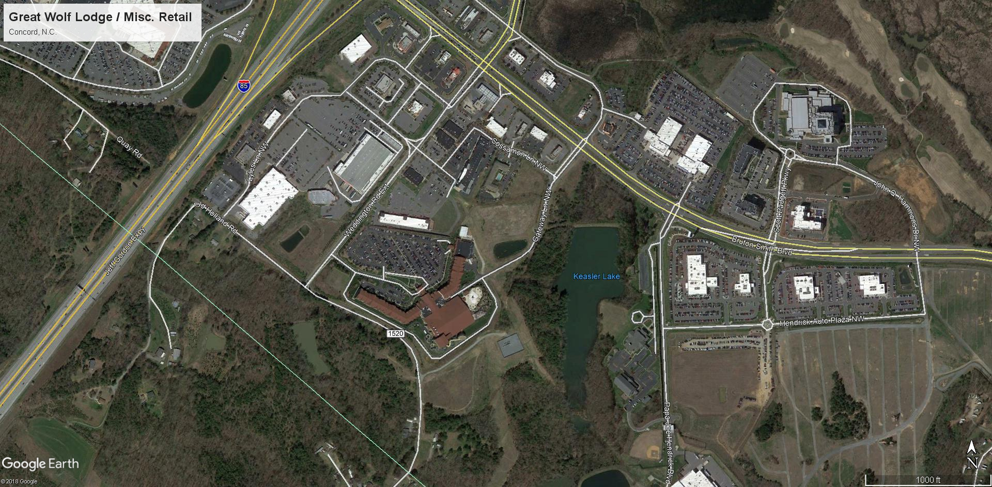

Slide 18
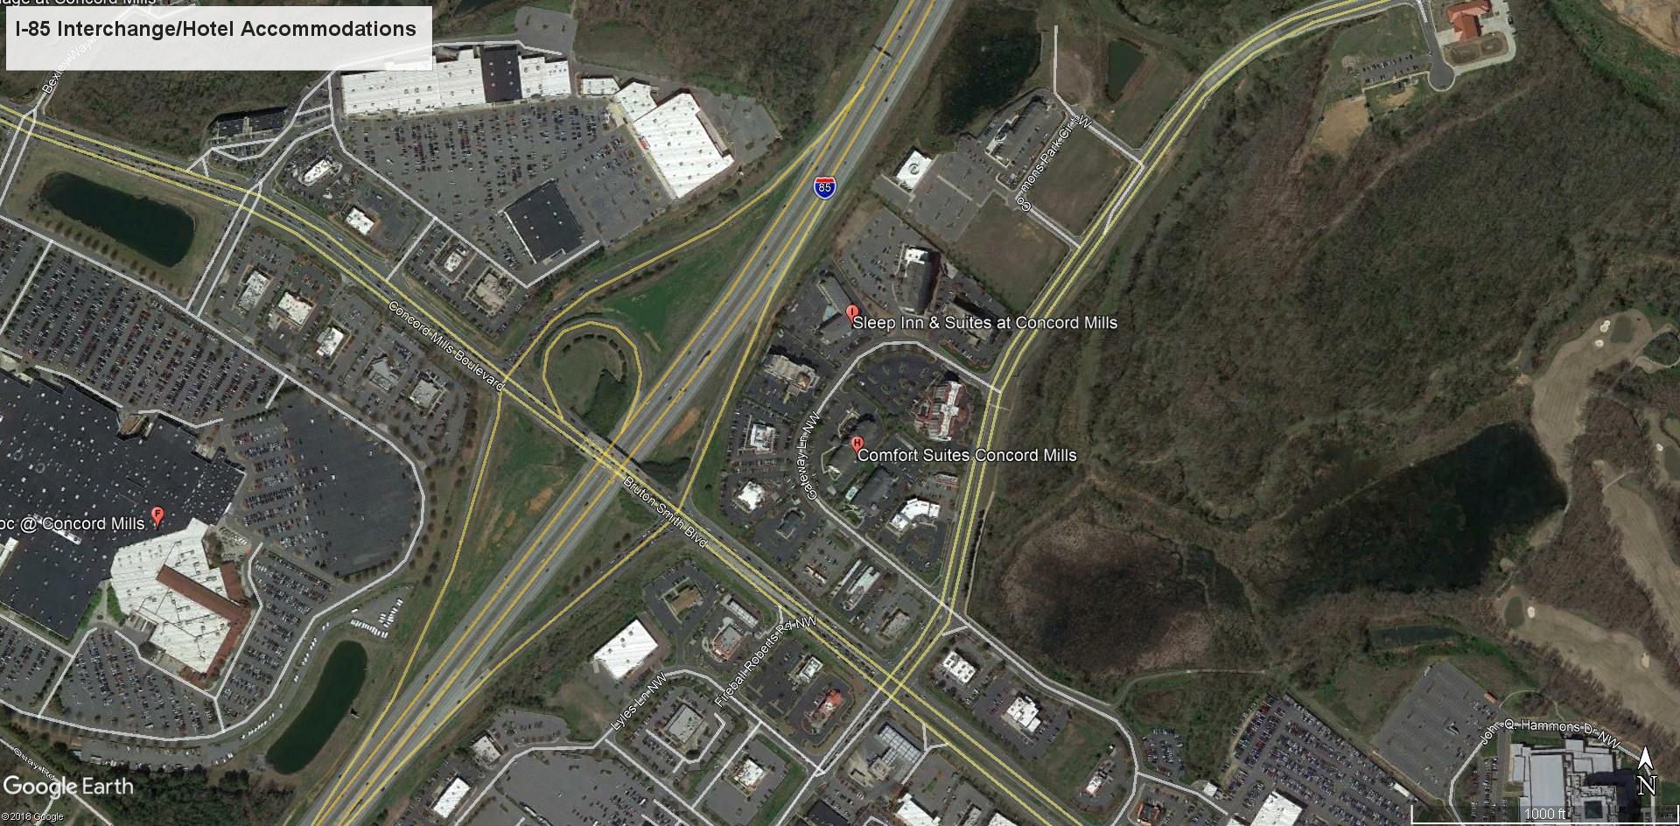

Slide 19
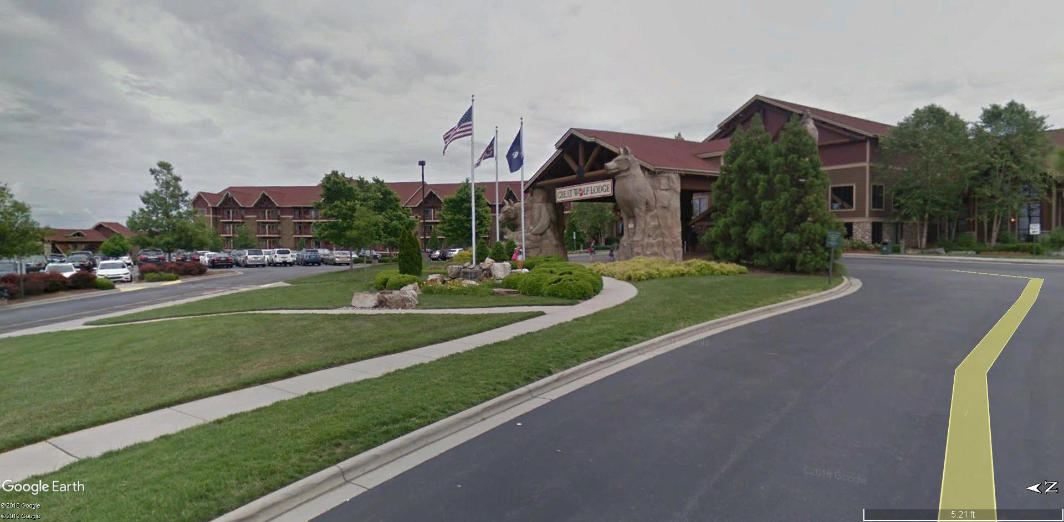

Slide 20
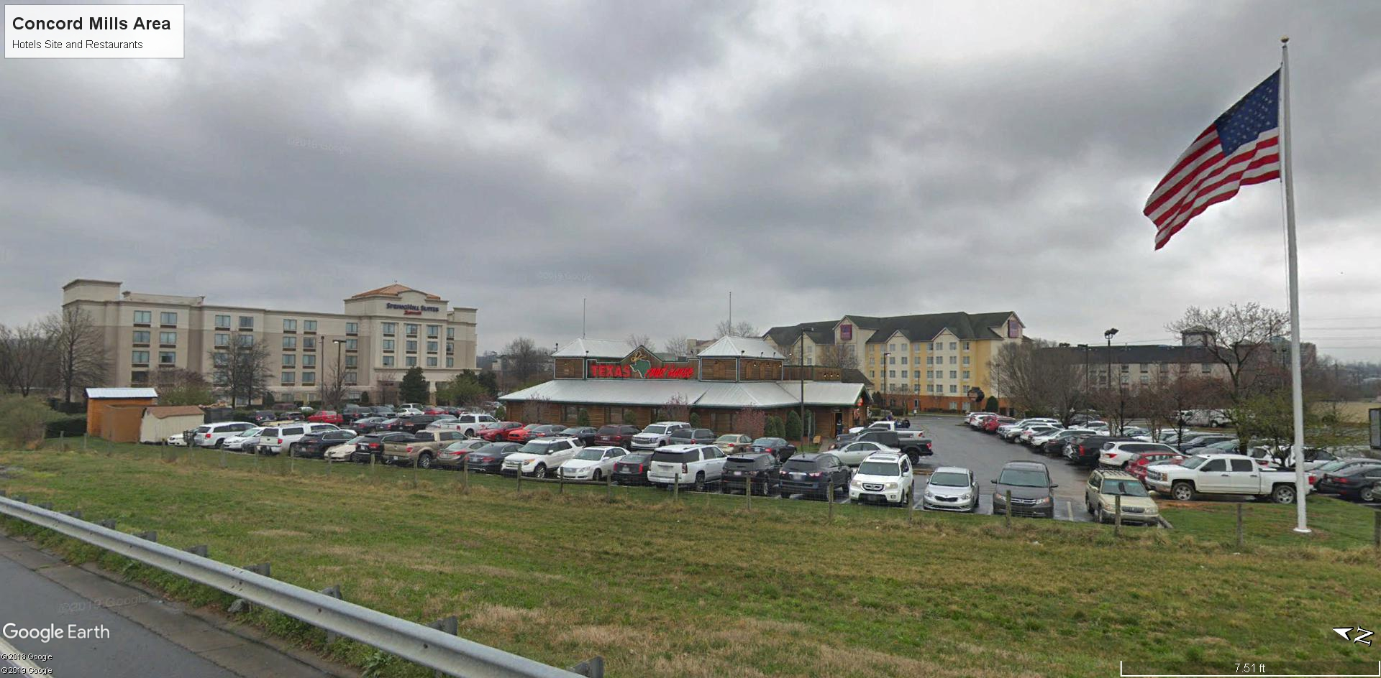

Slide 21
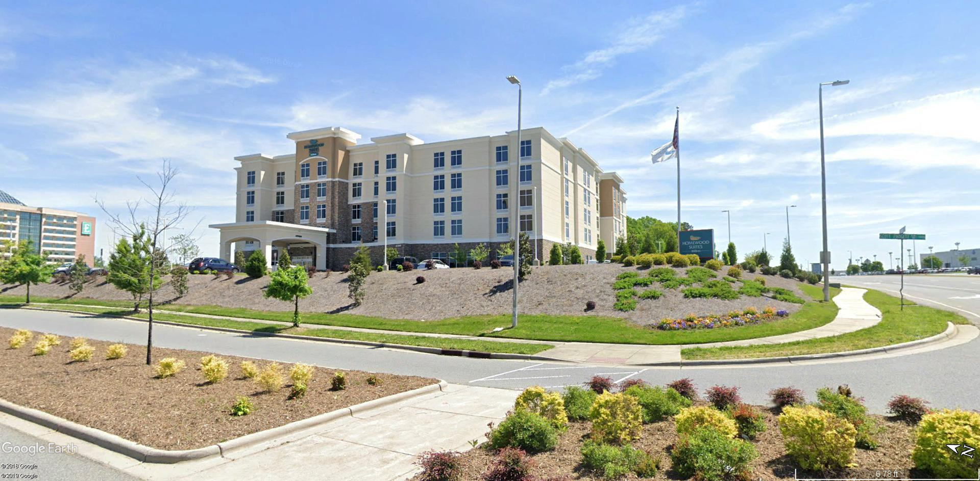

Slide 22
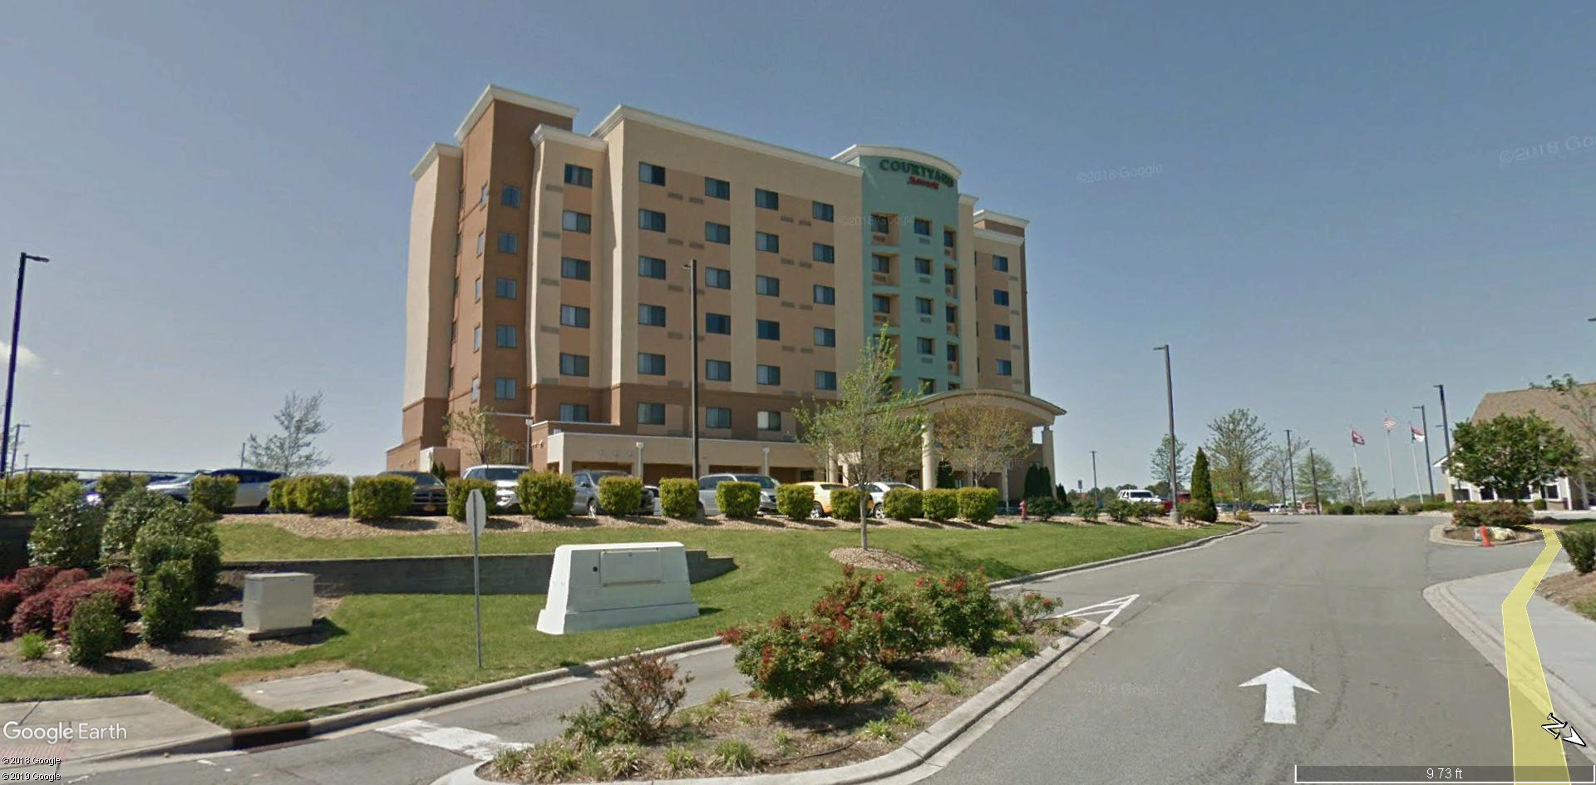

Slide 23
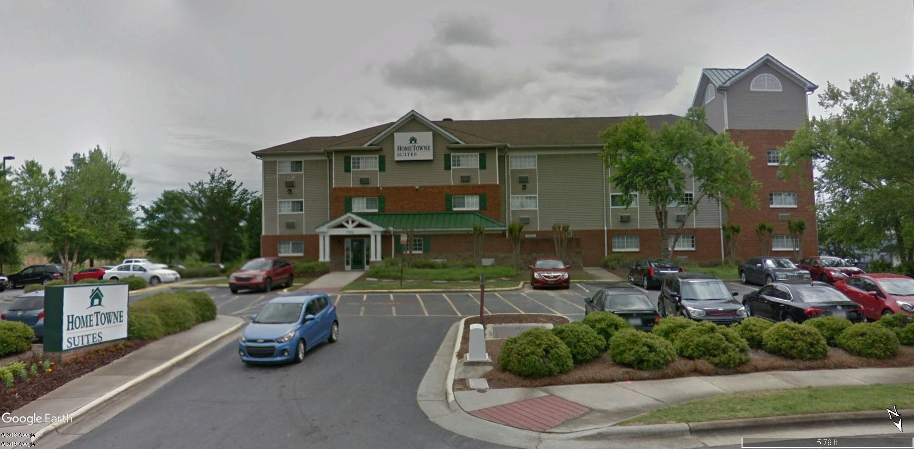

Slide 25
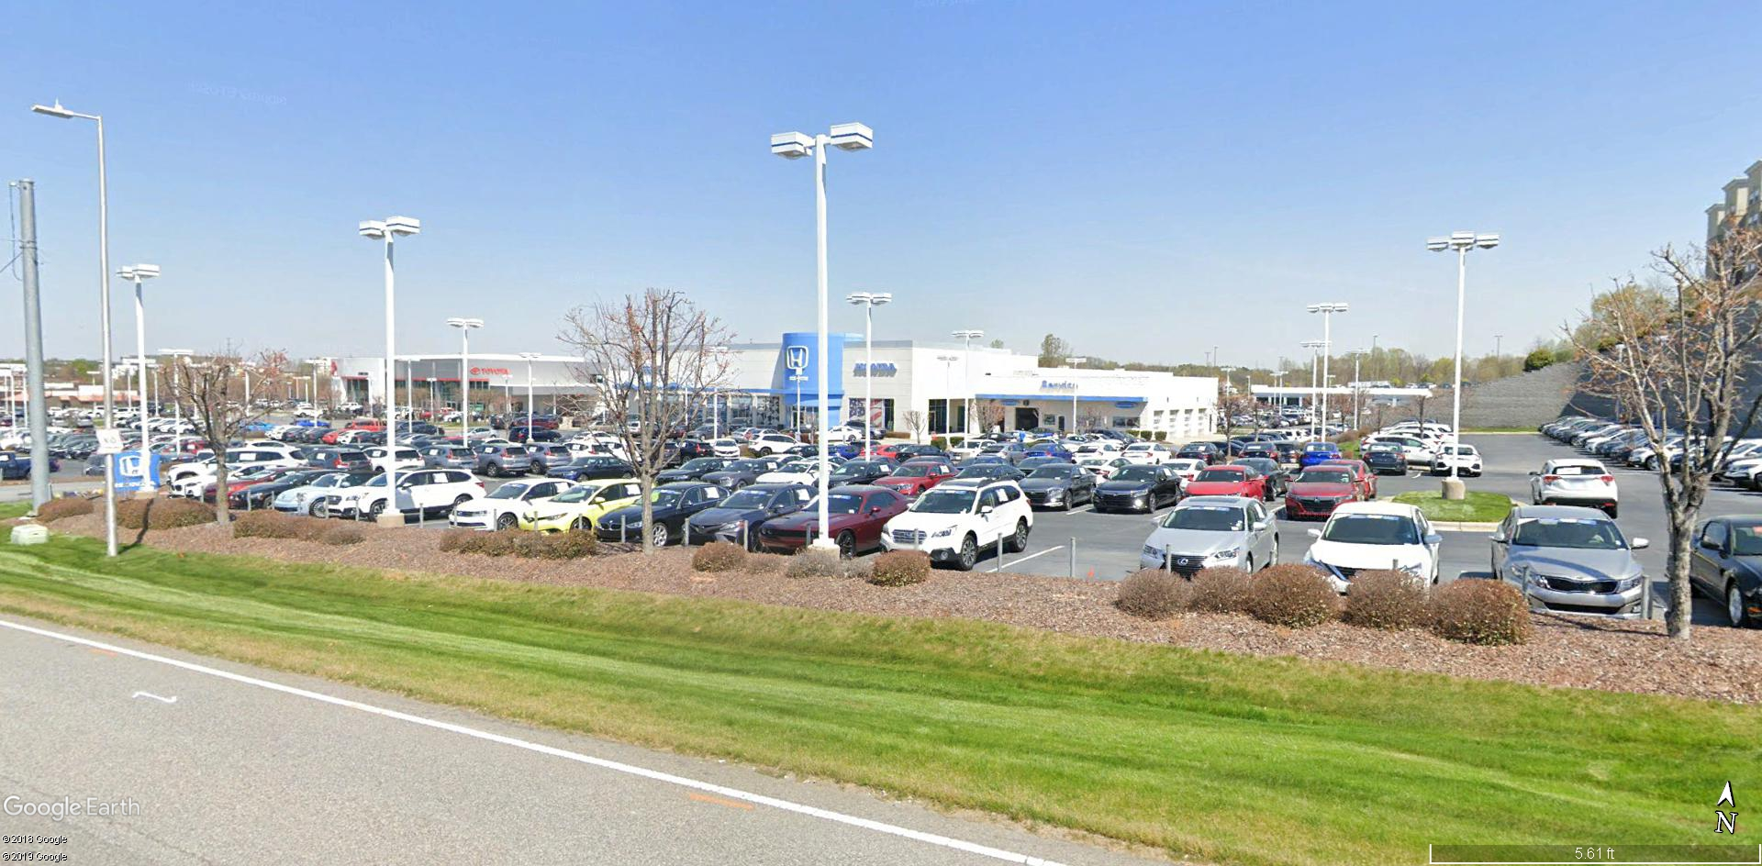

Slide 26
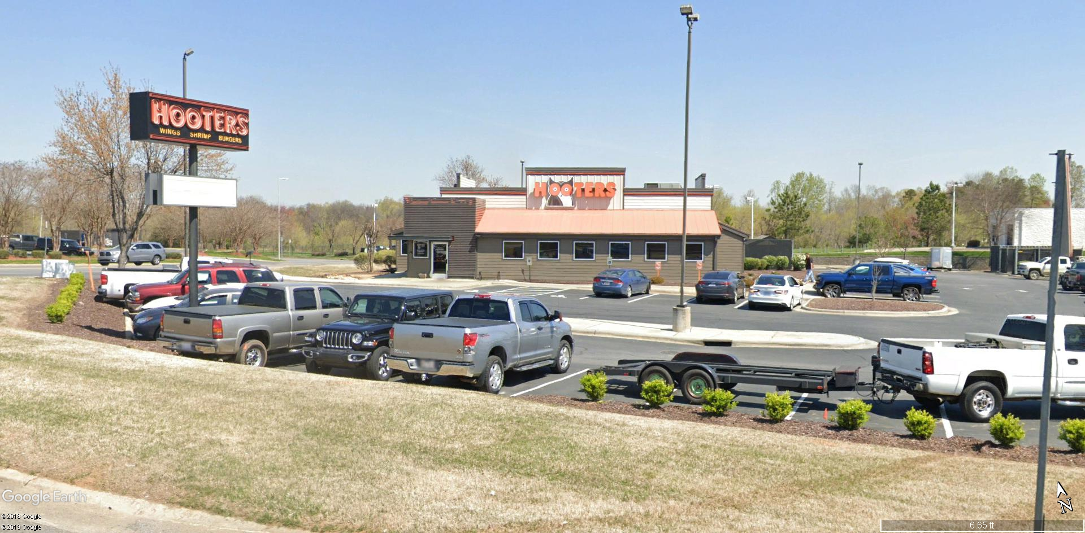

Slide 27
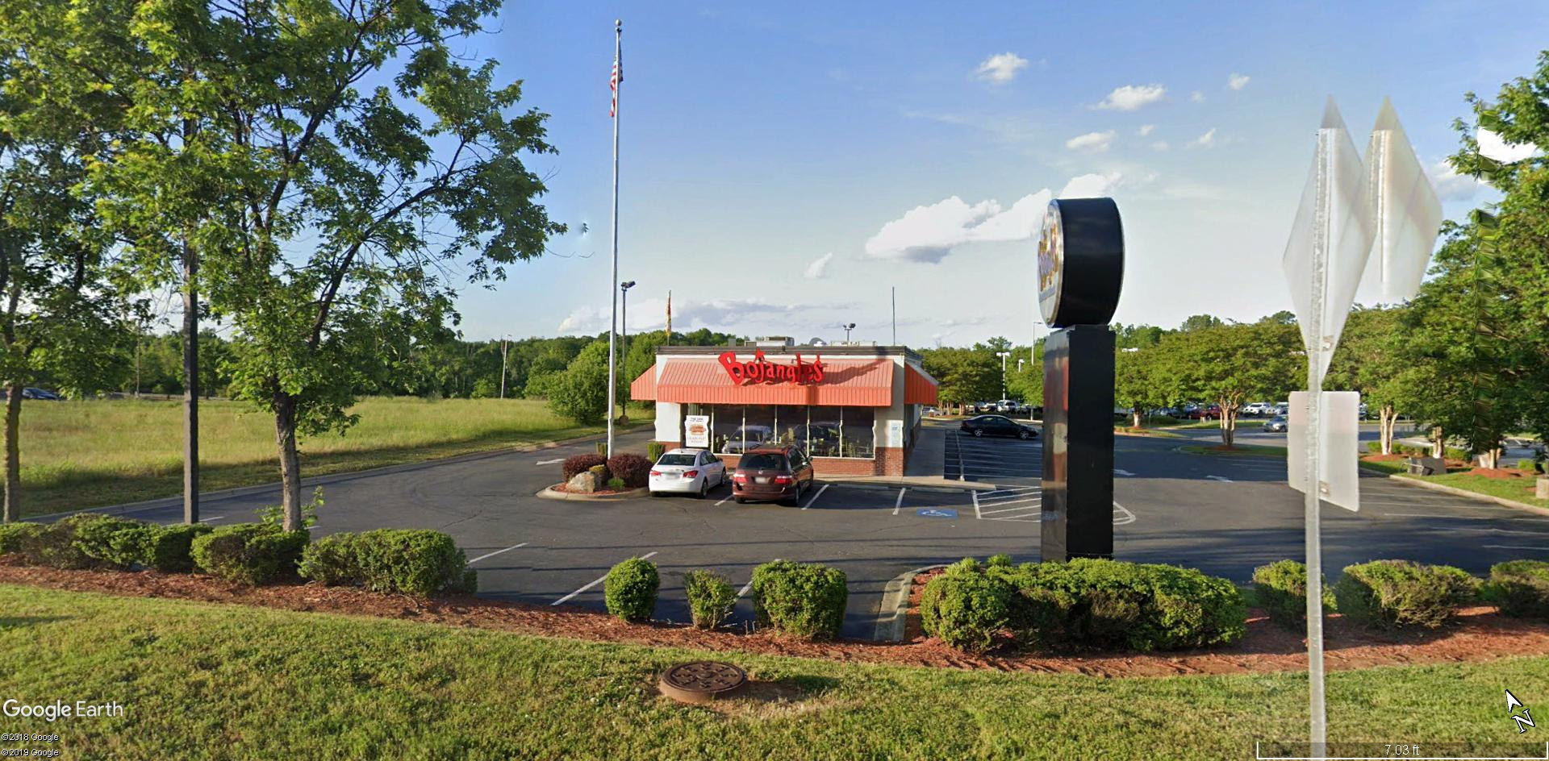

Slide 28
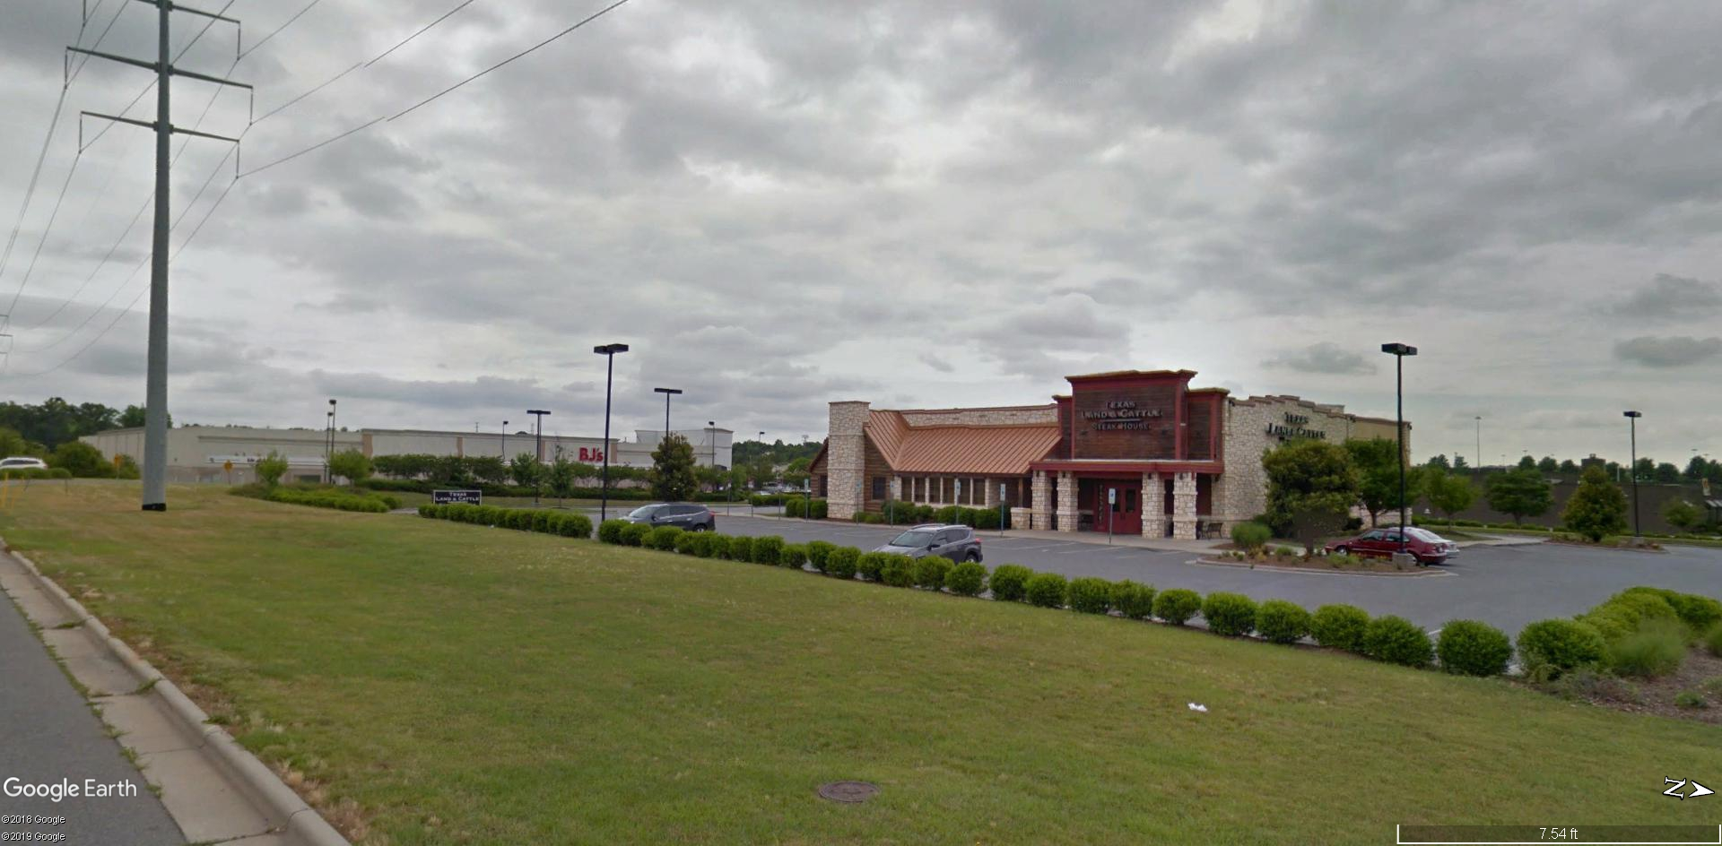

Slide 29
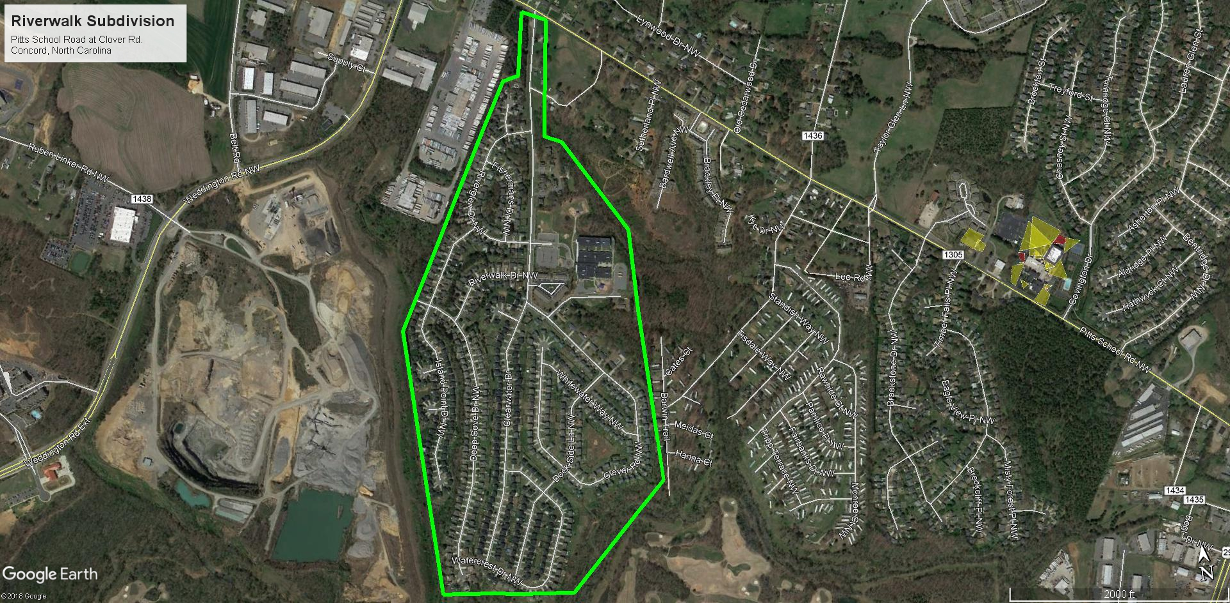

Slide 30
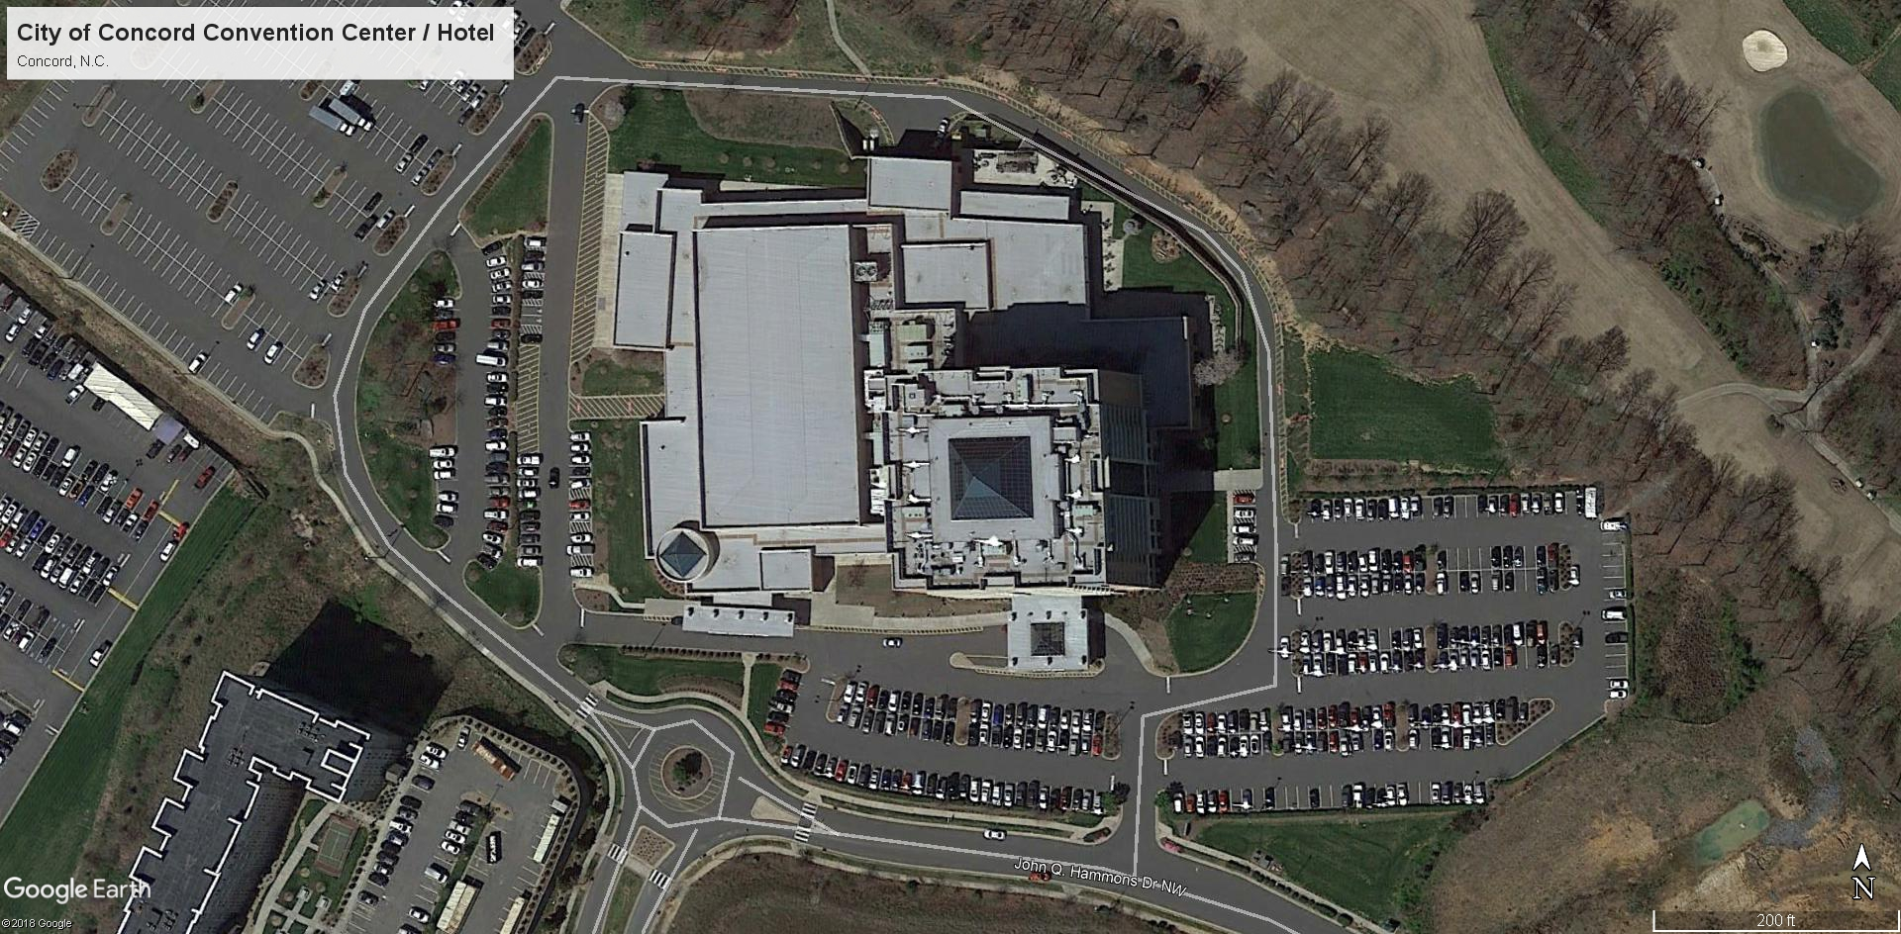

Slide 31
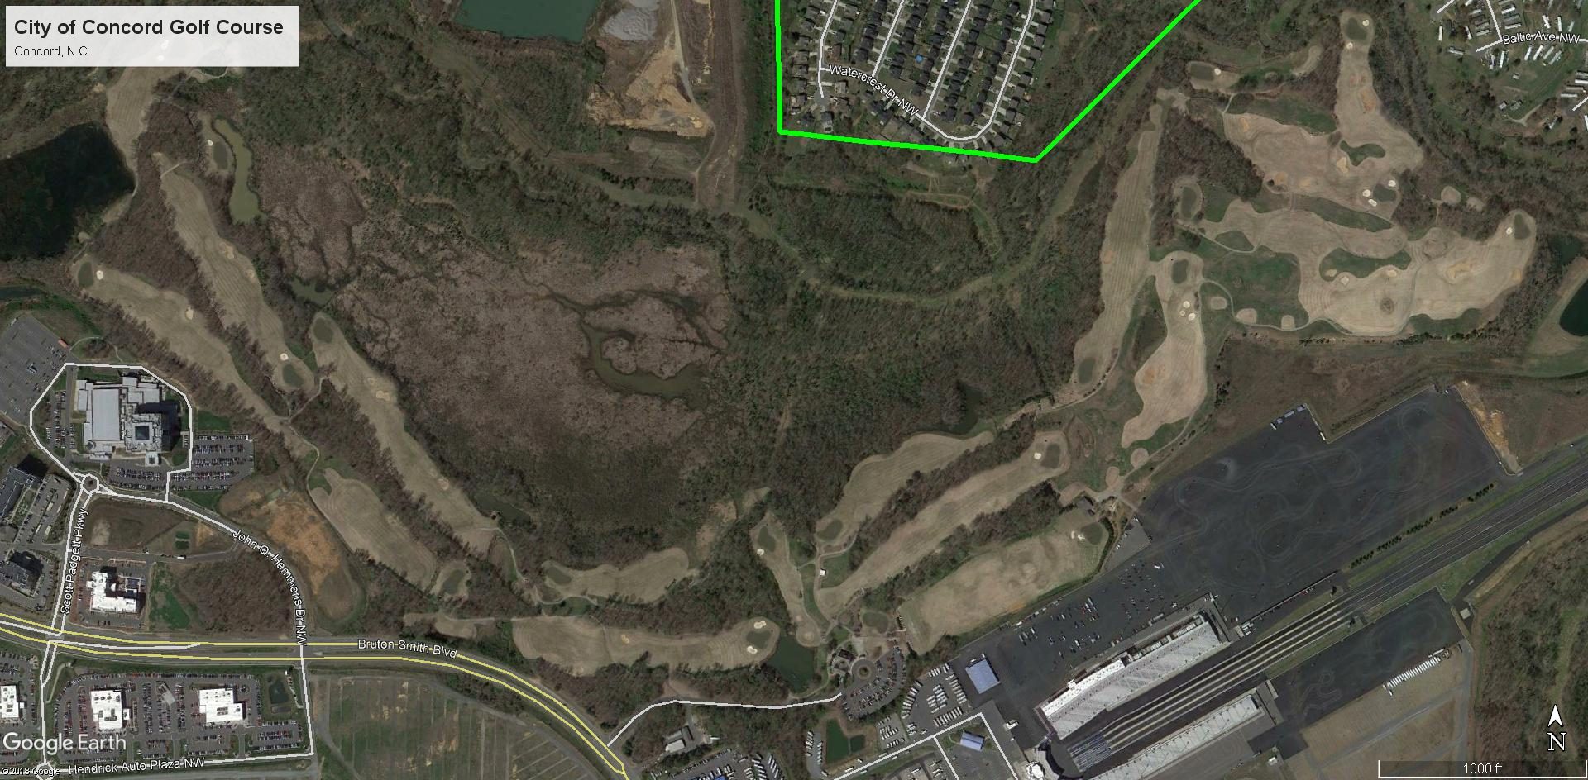

Slide 32
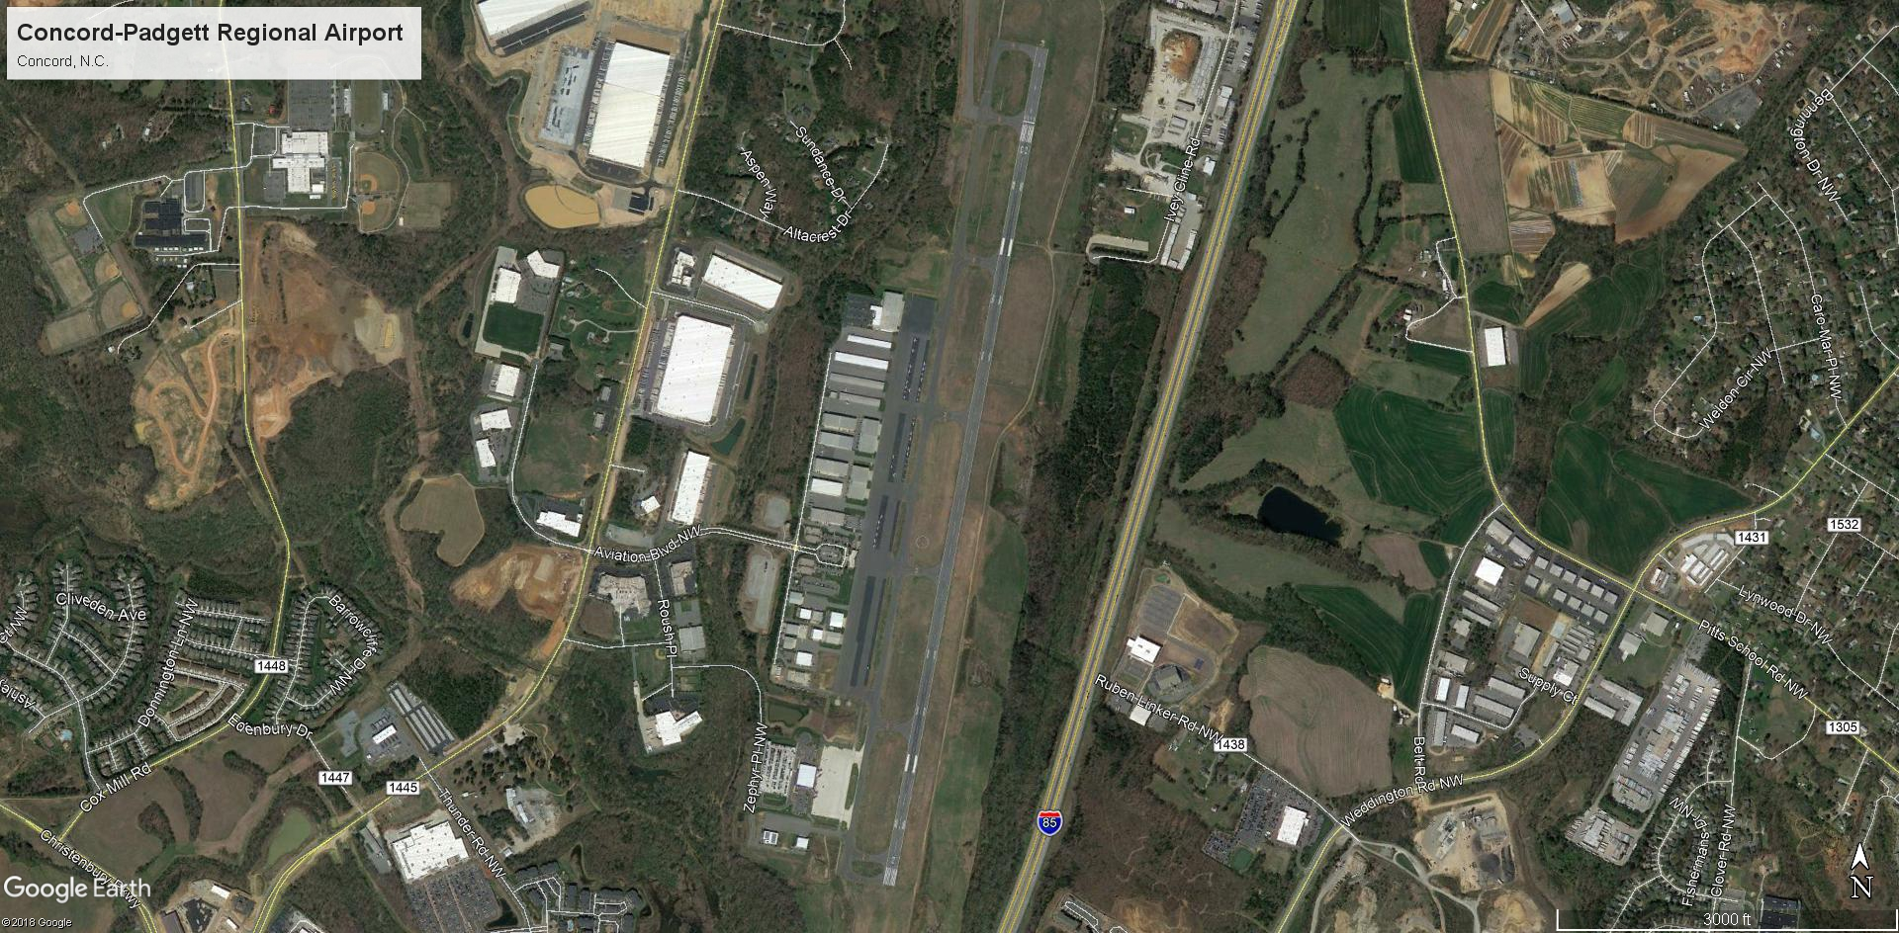

Slide 33
LAKE LAS VEGAS
HENDERSON, NEVADA

Slide 34
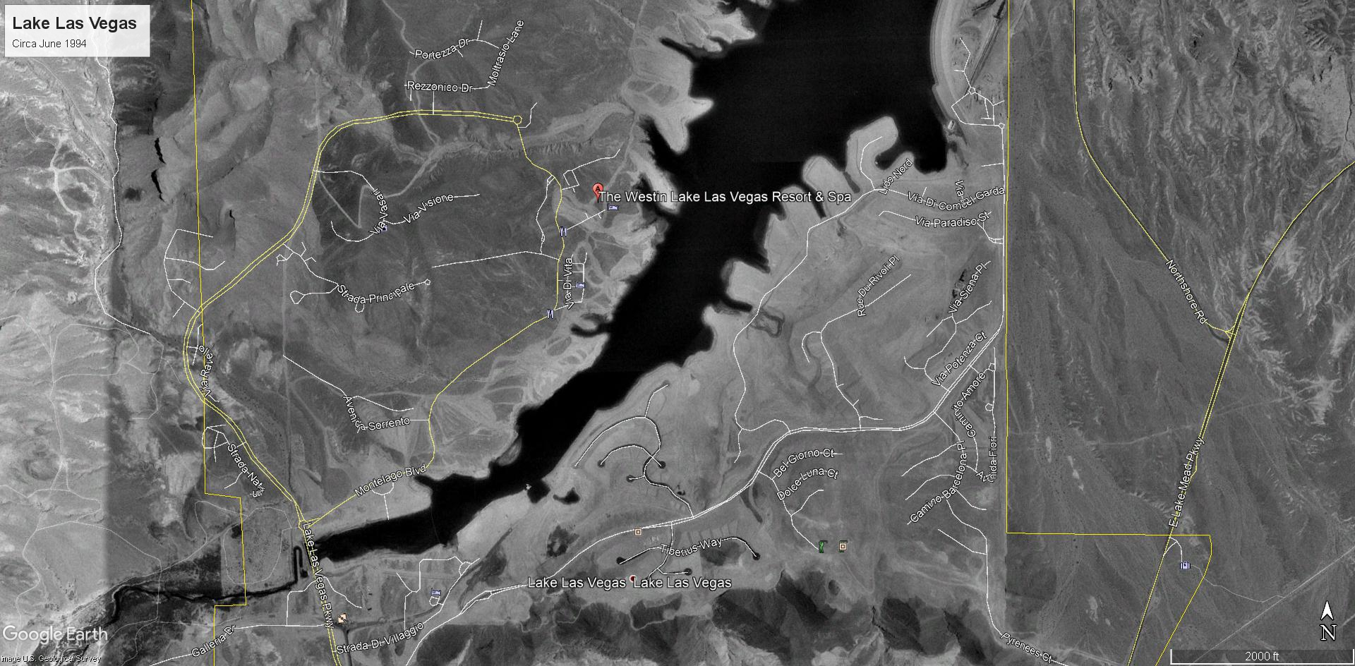

Slide 35
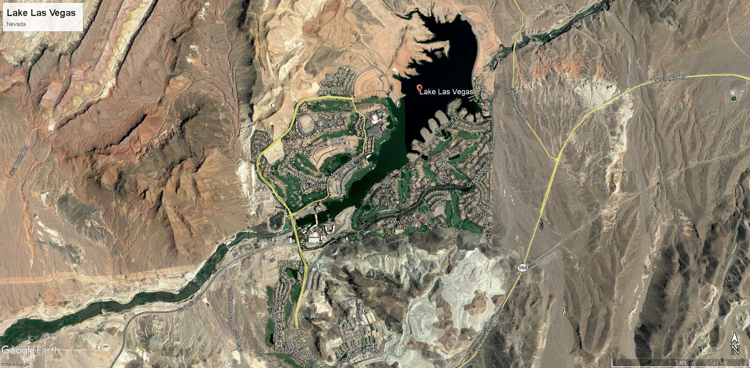

Slide 36
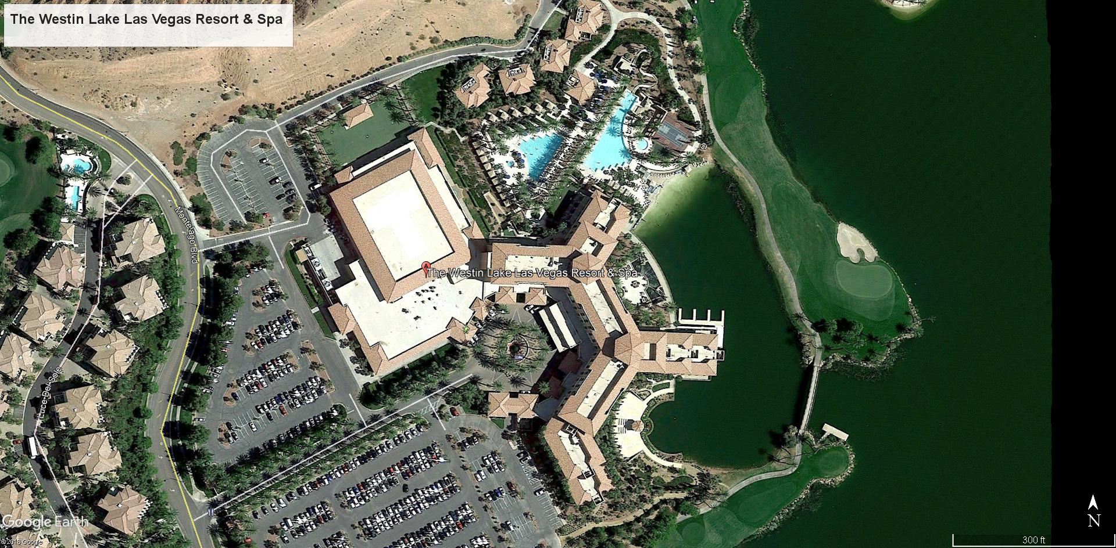

Slide 37
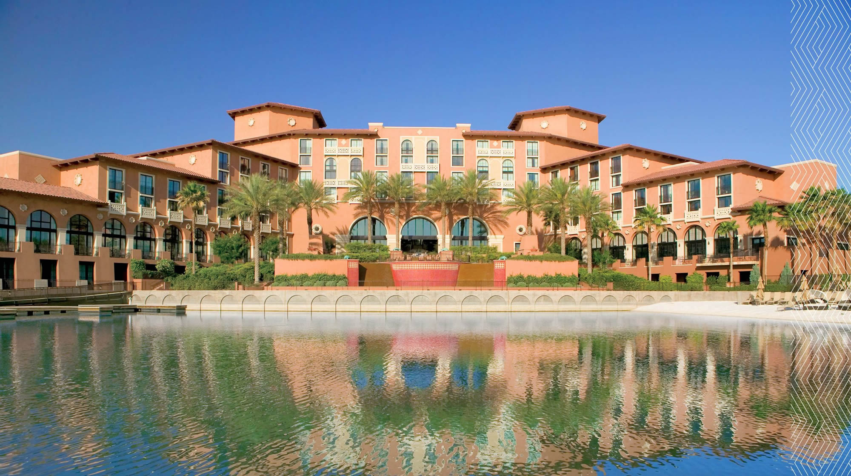

Slide 38
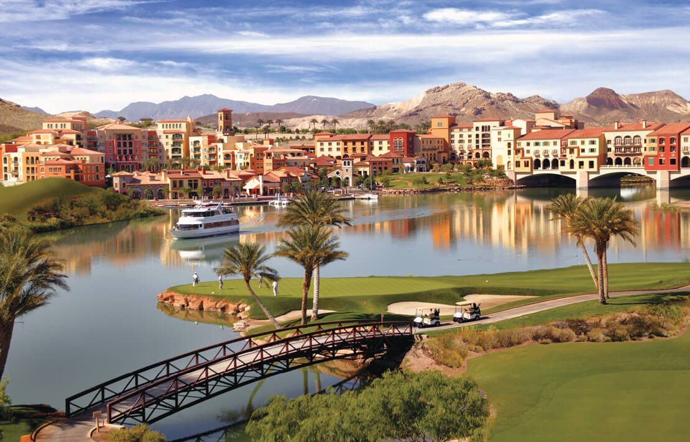

Slide 39
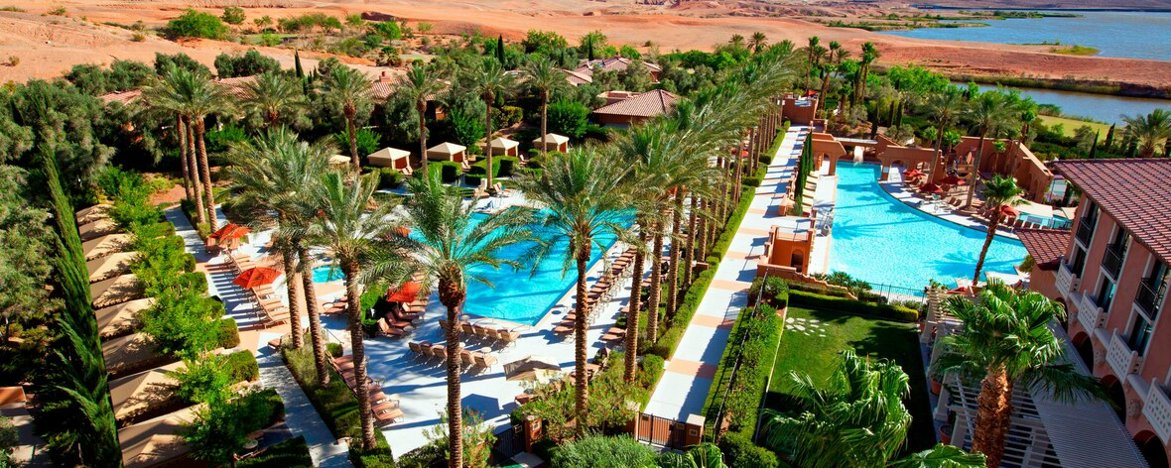

Slide 40
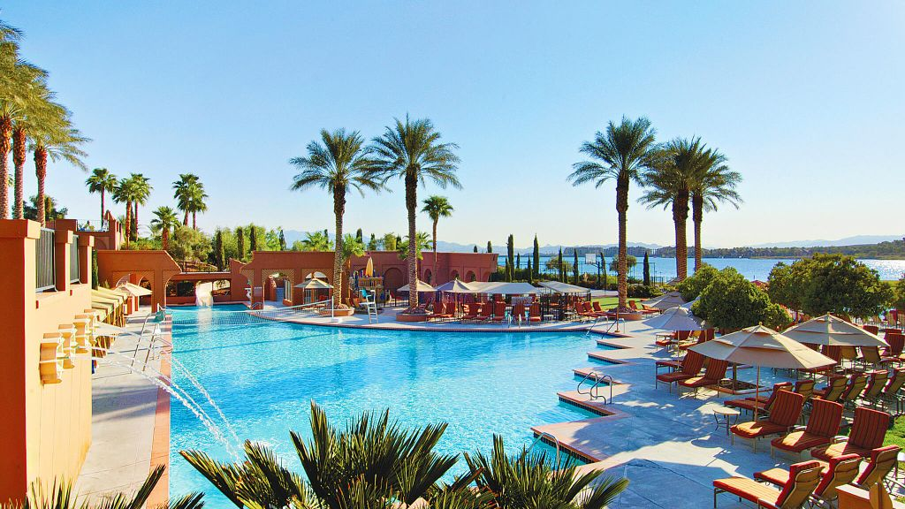

Slide 41
Former Myrtle Beach Air Force Base
Myrtle Beach, South Carolina

Slide 42
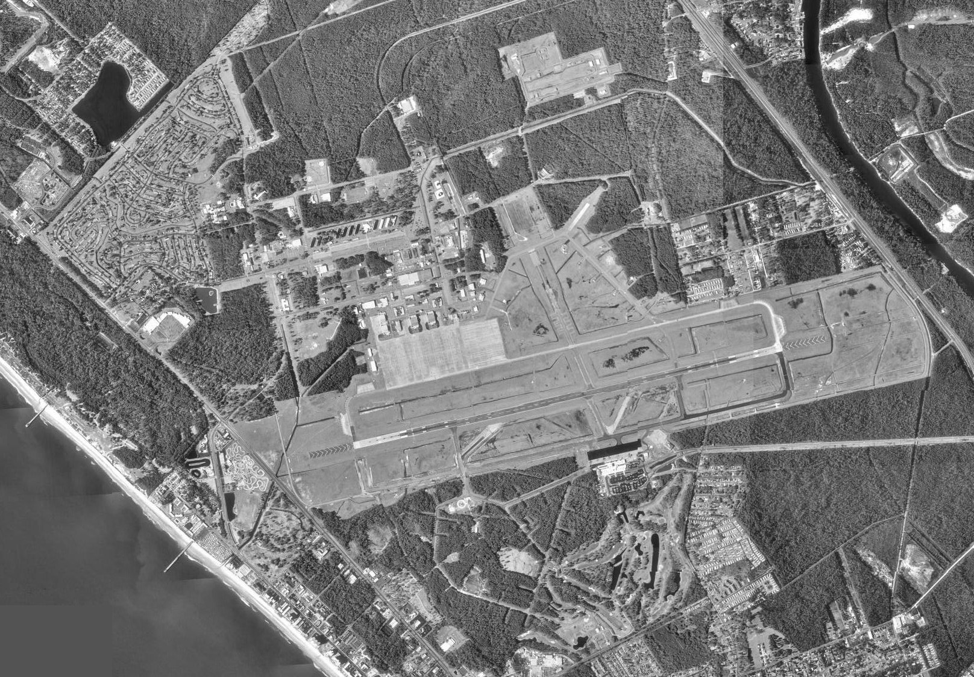

Slide 43
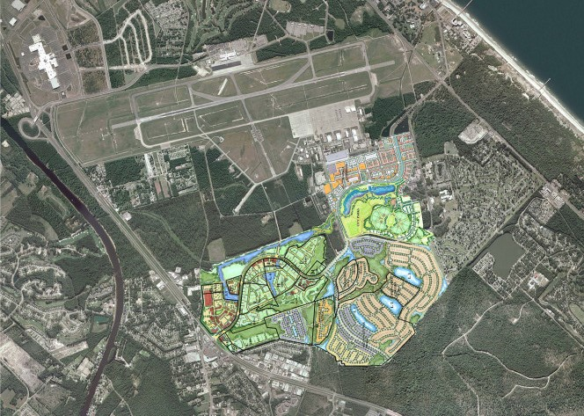

Slide 44
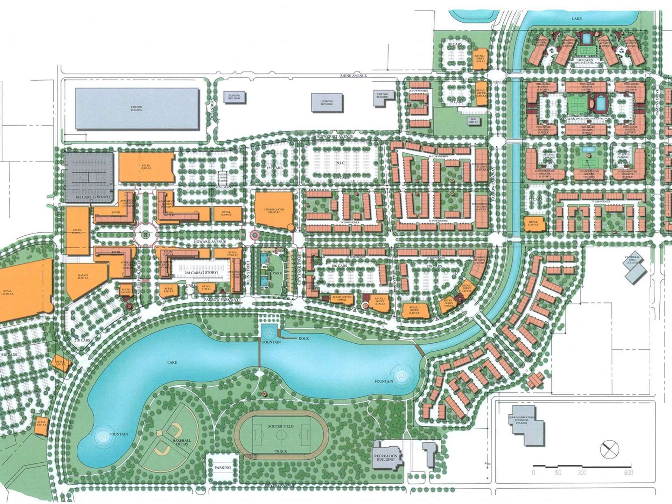

Slide 45
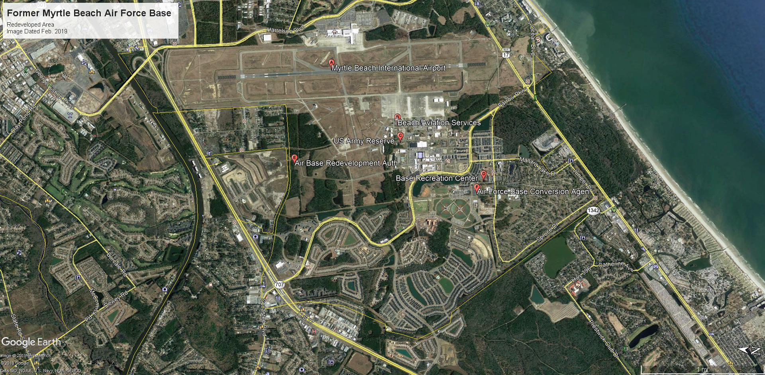

Slide 46
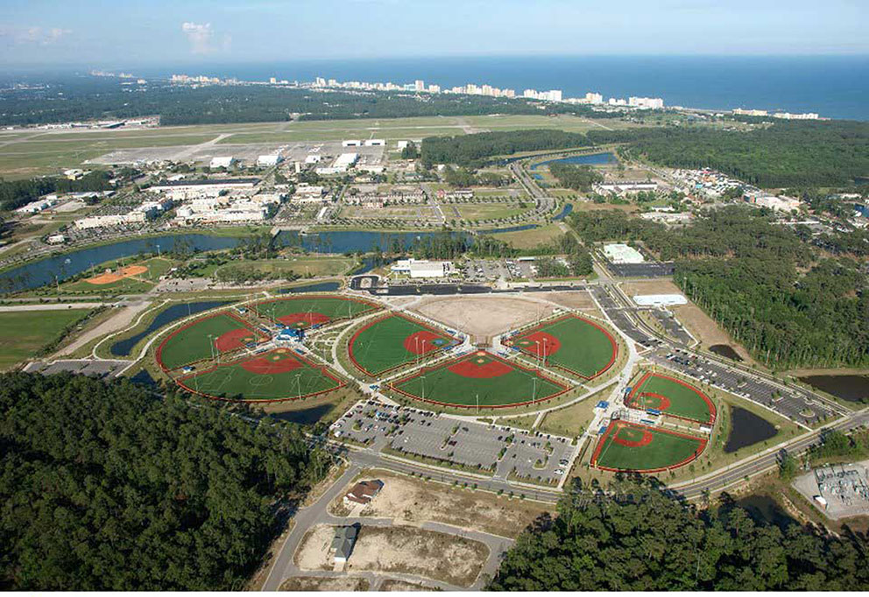

Slide 47
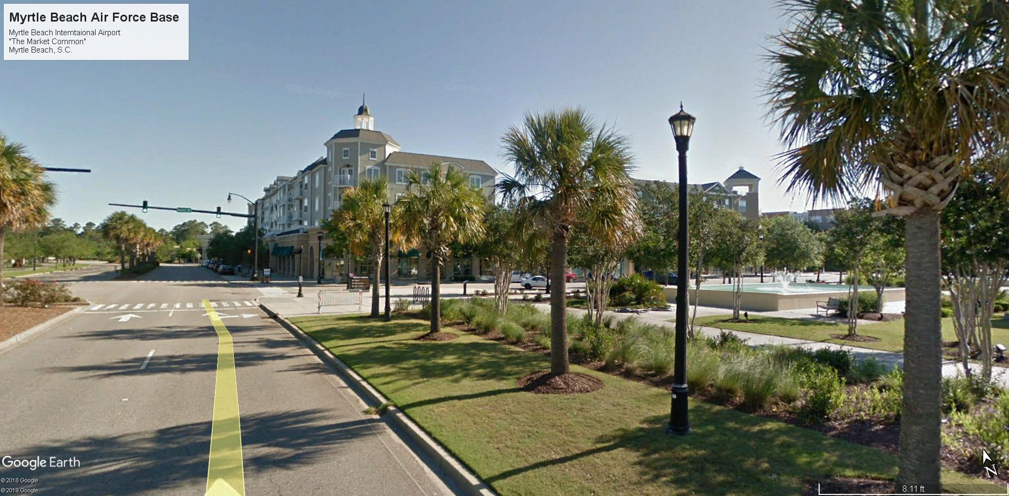

Slide 48
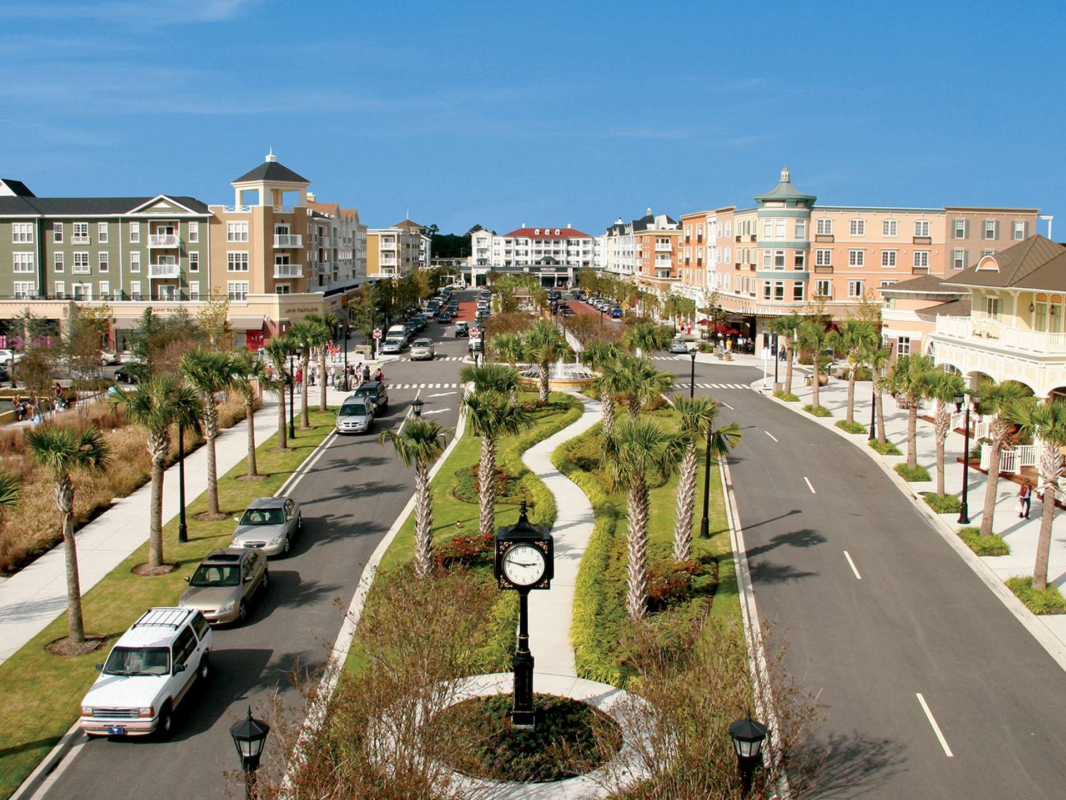

Slide 49
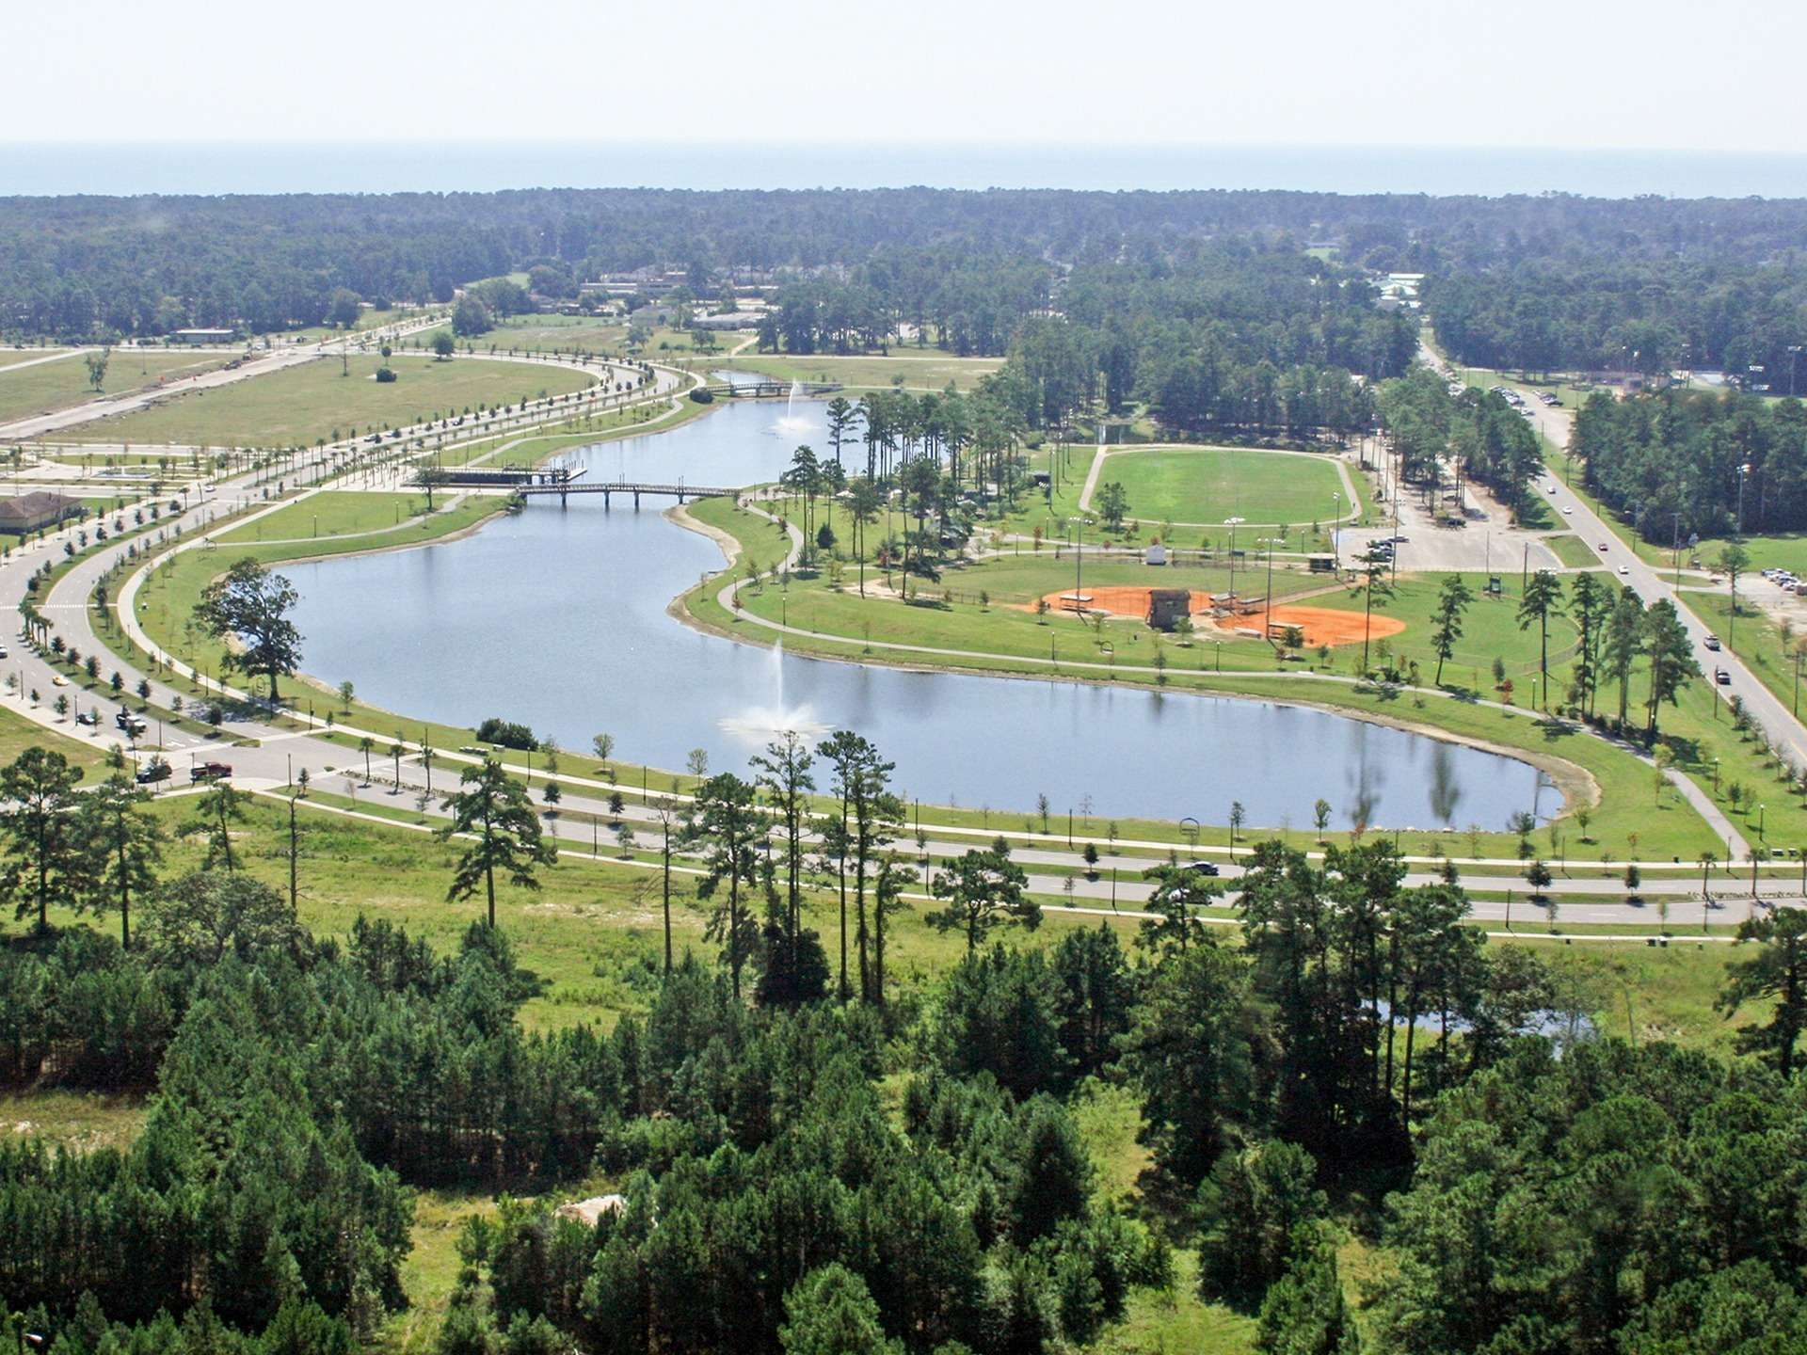

Slide 50
MYRTLE BEACH SOUTH CAROLINA
Build to Suits

Slide 51
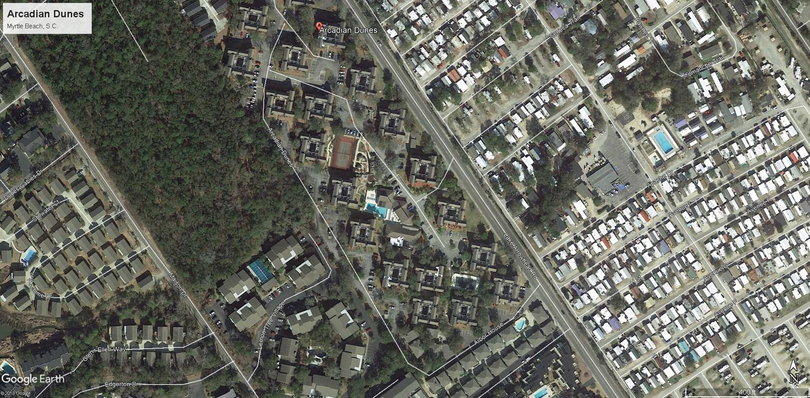

Slide 52
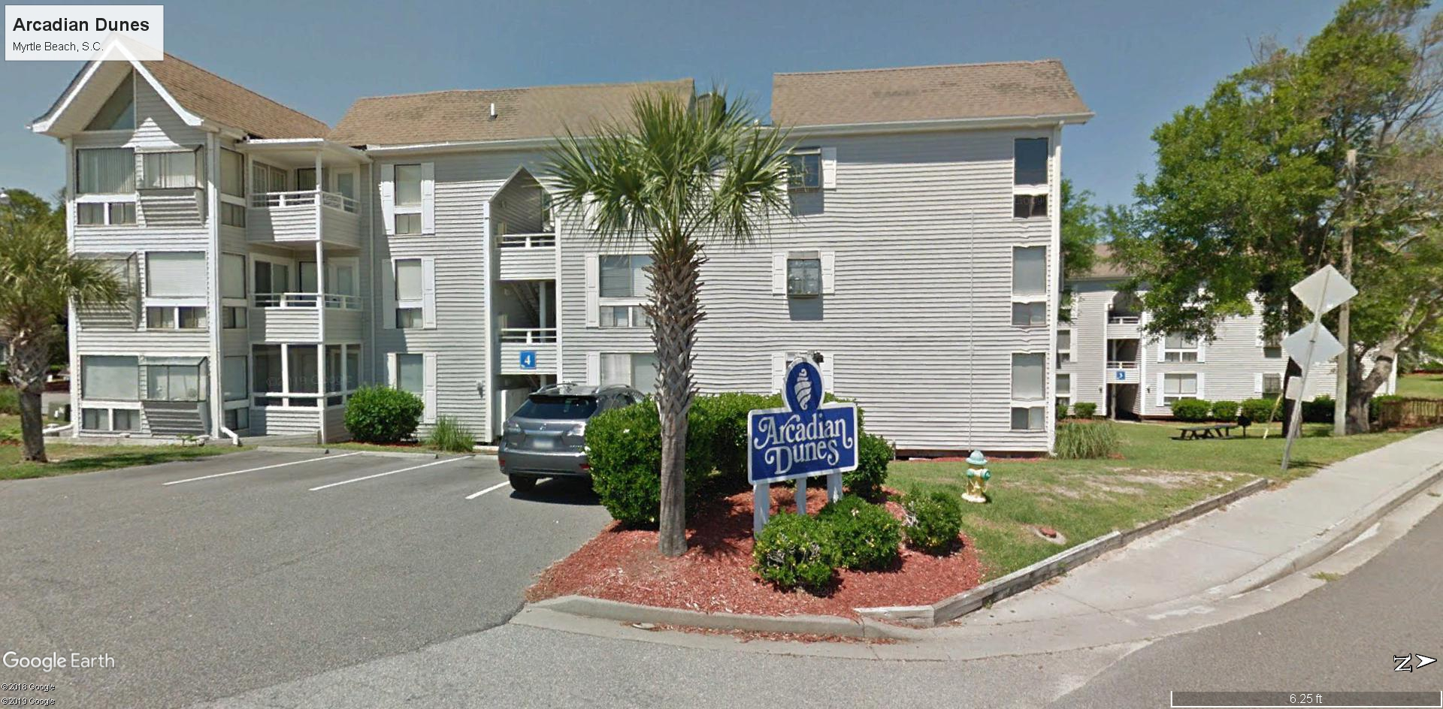

Slide 53
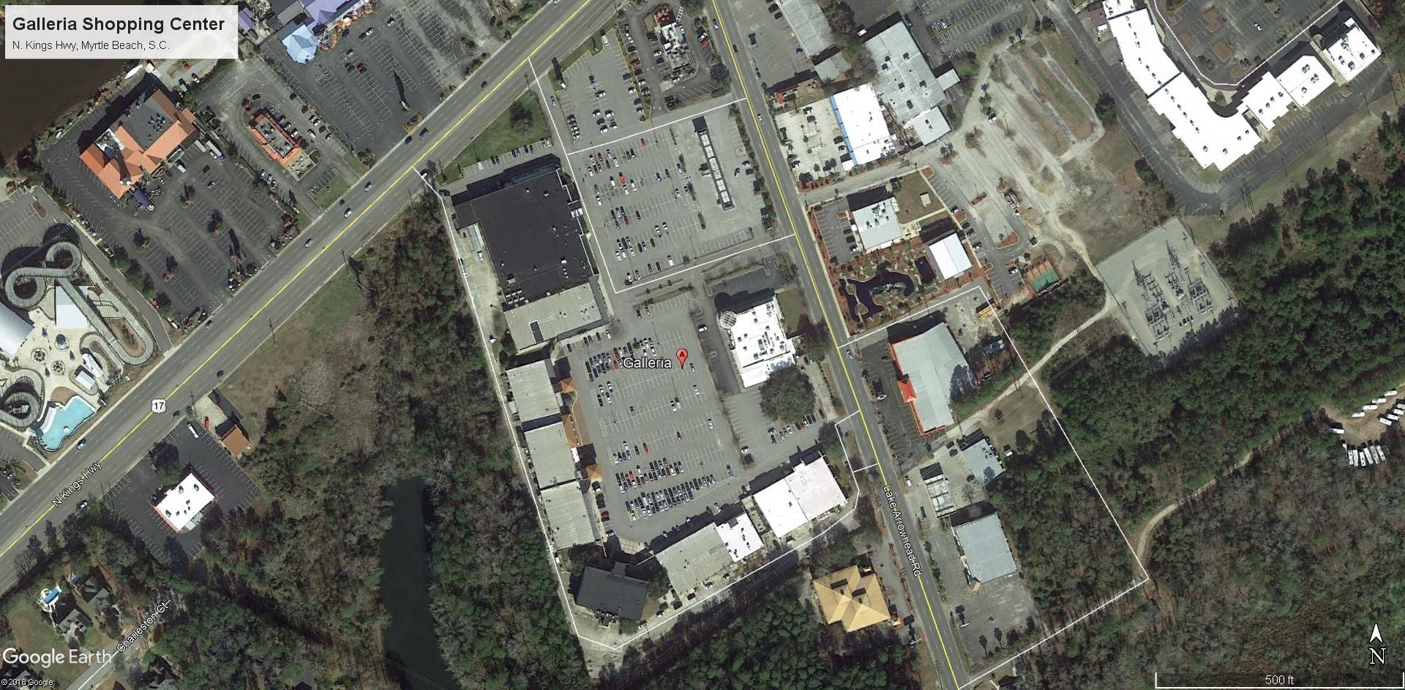

Slide 54
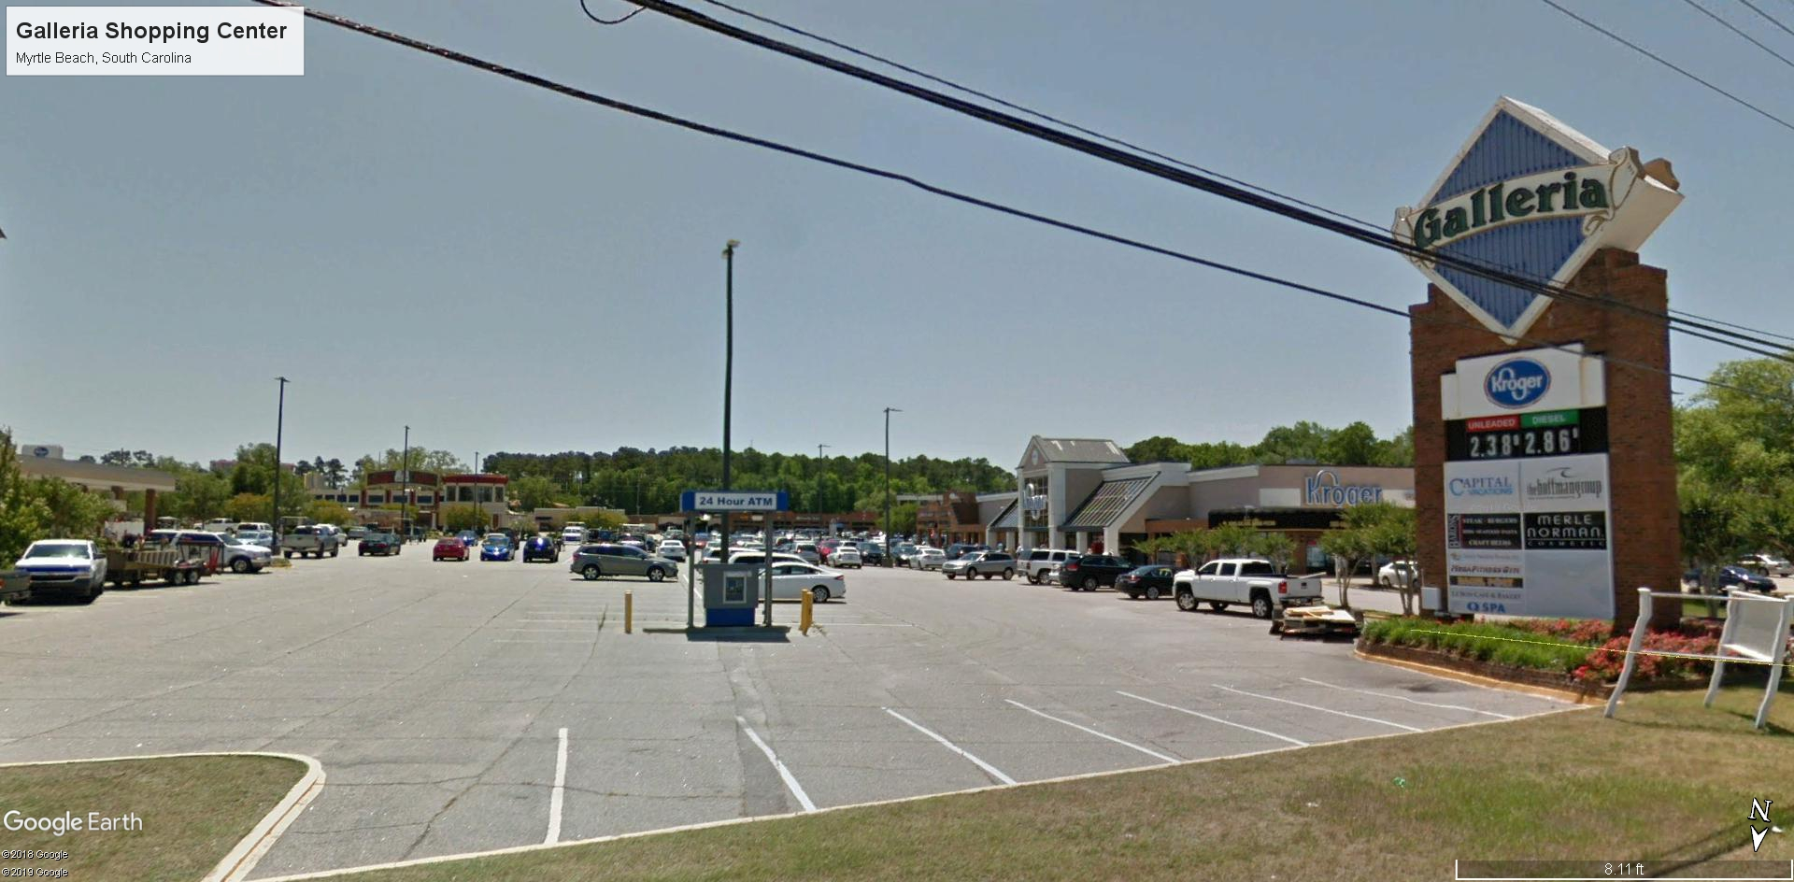

Slide 55
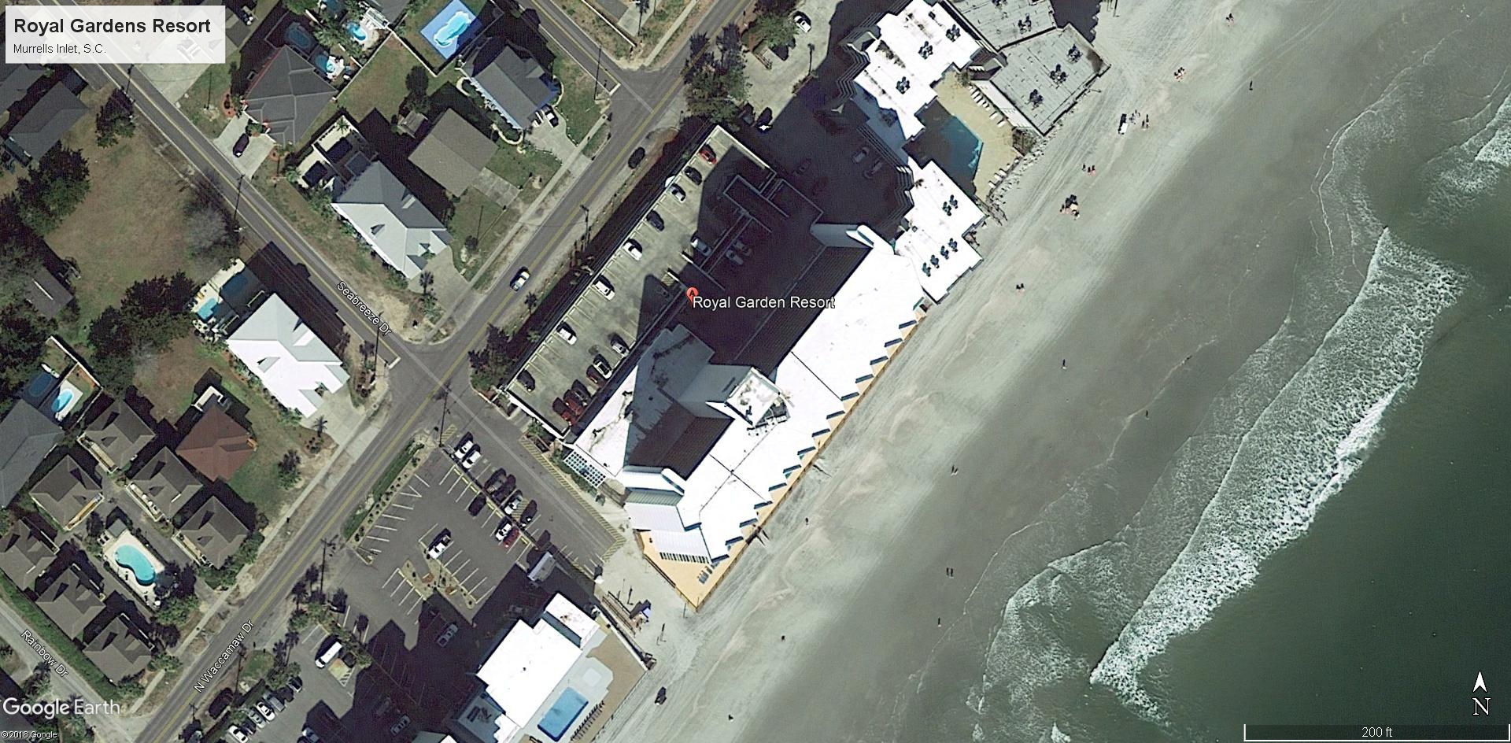

Slide 56
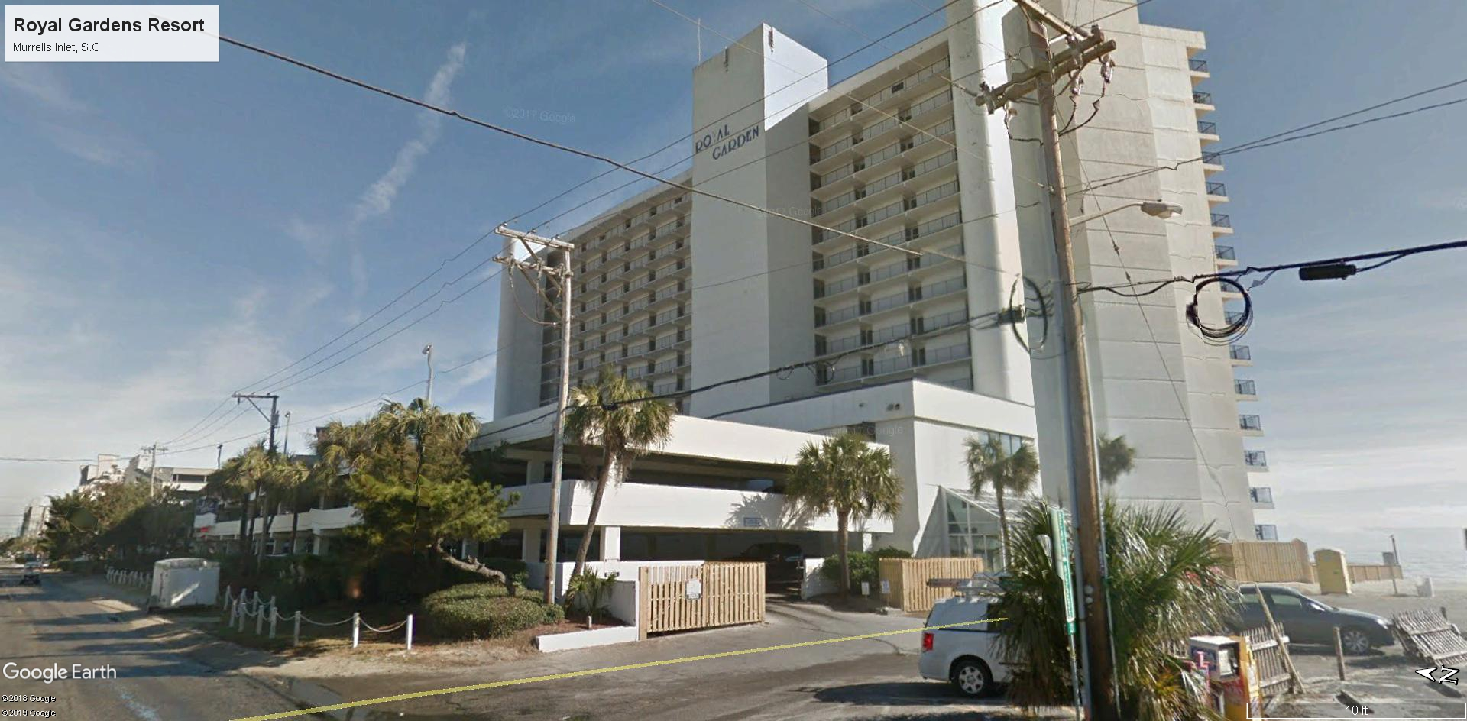

Slide 57


Slide 58


Slide 59
Twin Rivers Residential, Foscoe, North Carolina
Build-to-Suit Projects (Southeast and Mid-West)

Slide 60


Slide 61


Slide 62

Hooters of America 1712 Village West Parkway, Kansas City, KS

Slide 63

Hooters of America 6100 Southwest Tenth Street, Topeka, KS

Slide 64

Hooters of America 2701 Eastern Blvd., Montgomery, AL

Slide 65

What-A-Burger 8700 Ulmerton Road, Largo, FL

Slide 66
What-A-Burger 8700 Ulmerton Road, Largo, FL

Slide 67

Fresenius Medical Care Dialysis Center 1159 Glendale Road, Galax, VA

Slide 68

Bojangle’s 1568 Indian Trail-Lilburn Rd., Norcross, GA

Slide 69

Walgreens 1990 McCray’s Mill Rd. Sumter, S.C.

Slide 70

Quaker Steak and Lube 590 Chamber Dr. Milford, OH

Slide 71

Quaker Steak and Lube 2931 Mountaineer Blvd. Charleston, WV

